Slide 1

APPRENTICESHIPS
A GUIDE FOR PARENTS

Slide 2

Part 1: What’s an
apprenticeship?
It’s a real job where students learn, gain experience, study for a qualification and get paid.
An apprentice is an employee, with a contract of employment and holiday leave.
Over 650 different apprenticeships available, from Nuclear Engineer to Architect to Digital Marketer.

Slide 3
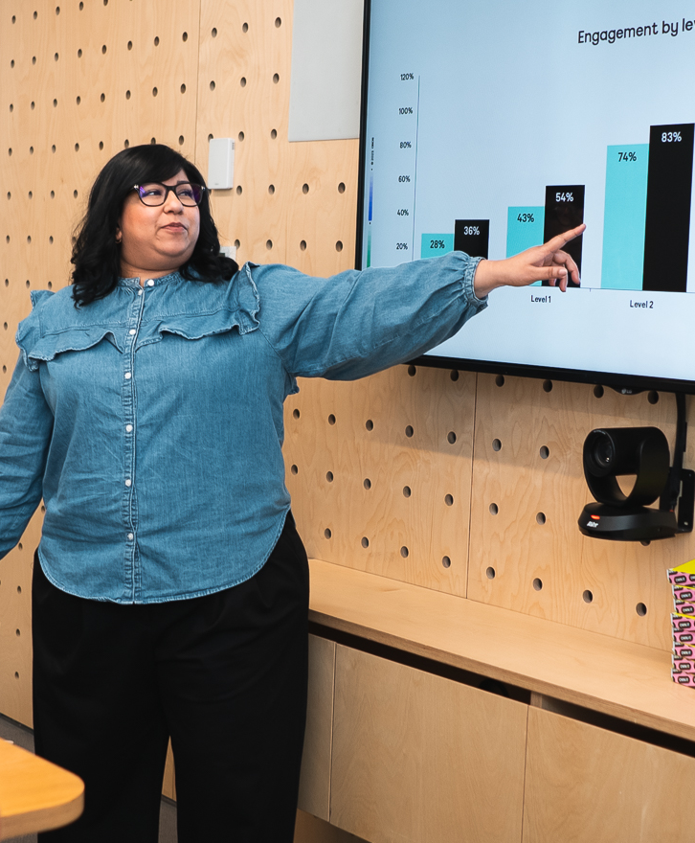
What are the
benefits?
Apprenticeships are funded by the Government and/or the employer so apprentices don’t have loans or tuition fees.
Wages vary depending on the industry but salaries can often be very competitive.
By the end of an apprenticeship, they’ll have the right skills and knowledge needed for their chosen career.

Slide 4

How does it work?
An apprenticeship takes between one to six years to complete.
Apprentices typically work for a minimum of 30 hours a week (and most will work full time, between 37 – 40 hours per week). Part-time options are also available in some cases.
Apprentices have time away from their day-job protected for study. This tends to equate to about a day a week and is also paid time.

Slide 5
Part 2: Apprenticeship levels
LEVEL 2
LEVEL 3
LEVEL 4+
LEVEL 6-7
Intermediate
Advanced
Higher
Degree
Job roles include Nuclear Operative, Junior Estate Agent, Rail Engineering Operative, Finance Assistant.
Job roles include
Chef De Partie, Fashion Assistant, Veterinary Nurse, IT Solutions Technician.
Job roles include Marketing Executive, Journalist, Clinical Dental Technician.
Job roles include Aerospace Engineer, Police Constable, Cyber Security, Ecologist.
GCSE
A LEVEL
FOUNDATION DEGREE+
BACHELOR’S OR MASTER’S DEGREE

Slide 6

Types of
apprenticeships
There are over 650 different apprenticeship roles to consider. Here are some examples:
Architect
Cyber Security Technician
Finance assistant
Software developer
Accounting & Taxation
Game Programmer
Boat Builder
Journalist
Solicitor
Event Assistant
Auto technician
Youth Worker
Civil Engineer
Sports Coach
Digital Marketer
Personal Trainer

Slide 7
Apprenticeships/Jobs 2025
Apprenticeship at MHA in Accounting
Apprenticeship at KPMG Level 6 Tax Audit
Apprenticeship at Balfour Beatty in Civil Engineering
Apprenticeship in Construction Quantity Surveying
Electrician Apprenticeship
Junior Clerk at Doughty Street Chambers
Apprenticeship in Civil/Structural Engineer Level 6
Level 7 Apprenticeship at Price Bailey in Accountancy
Job with Accredited training at Gallagher in Insurance (CII Certificate in Insurance)
Apprenticeship in Recruitment
Apprenticeship at Munich Re in Insurance
Business operations analyst in asset servicing in Euroclear company
Apprenticeship in Production Control at Classified Central Media
Apprenticeship at Parkway Primary School as an LSA
HR Job at Jaguar
Admin Assistant at Riverside Financial Consulting
Police Constable Apprenticeship Level 6
MEP Digital Engineering Apprenticeship with Laing O’Rourke (level 6)
Maples group Law company (Job)
Apprenticeship at Zurich Insurance in Retail/Distribution

Slide 8
Apprenticeships…you need to consider this…
It’s a real job, you have to be there on time and do what’s expected of you!
Working and studying on the job can be tough
Although there are chances to socialise and meet new people. It won’t be like going to university!
You’ll get paid….however you will also pay tax and National Insurance

Slide 9
Applying for an apprenticeship
As an apprenticeship is a job, you apply directly through the employer
You will need to submit a CV/letter of application
There will be an interview – likely to be on-line initially
There may be an assessment to complete

Slide 10
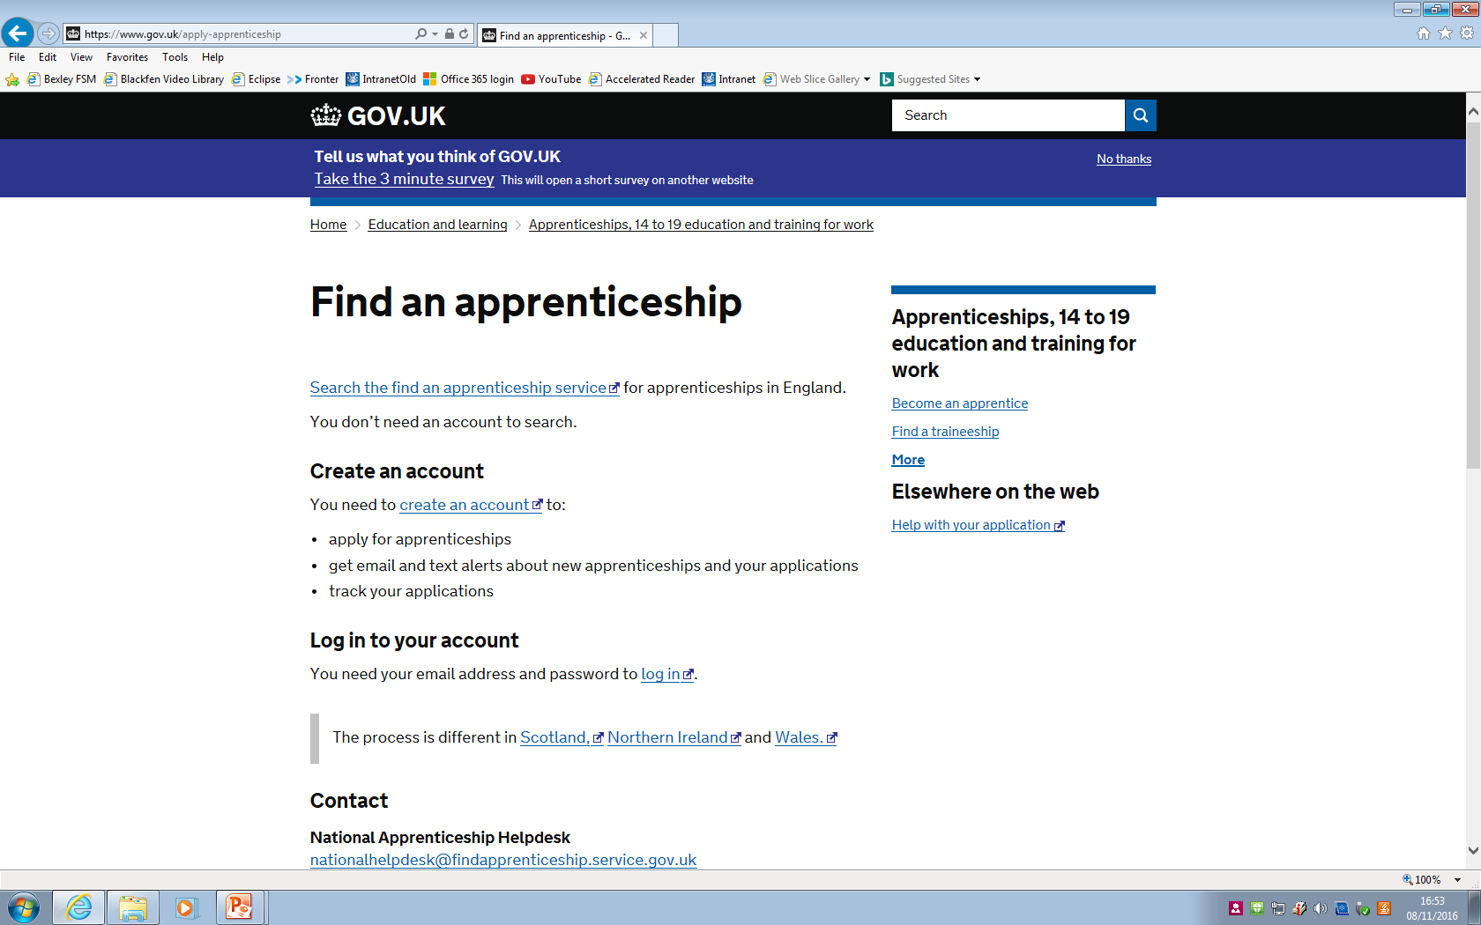
How to apply for an apprenticeship
www.gov.uk/apply-apprenticeship
Notes:
Speaker notes:
Due to demand from business and backing from the government Higher Apprenticeships are expanding. Apprentices’ opportunities for career progression are increasing with the expansion of Higher Apprenticeships (levels 4-7). Equivalent to a degree, more of these specialised and highly skilled Apprenticeships are being offered each year, giving individuals the chance to continue their professional development and realise their full potential.

Slide 11
https://www.amazingapprenticeships.com/higher-degree-listing/?utm_source=homepage+banner&utm_medium=h%26d+jan&utm_campaign=naw2025

Slide 12

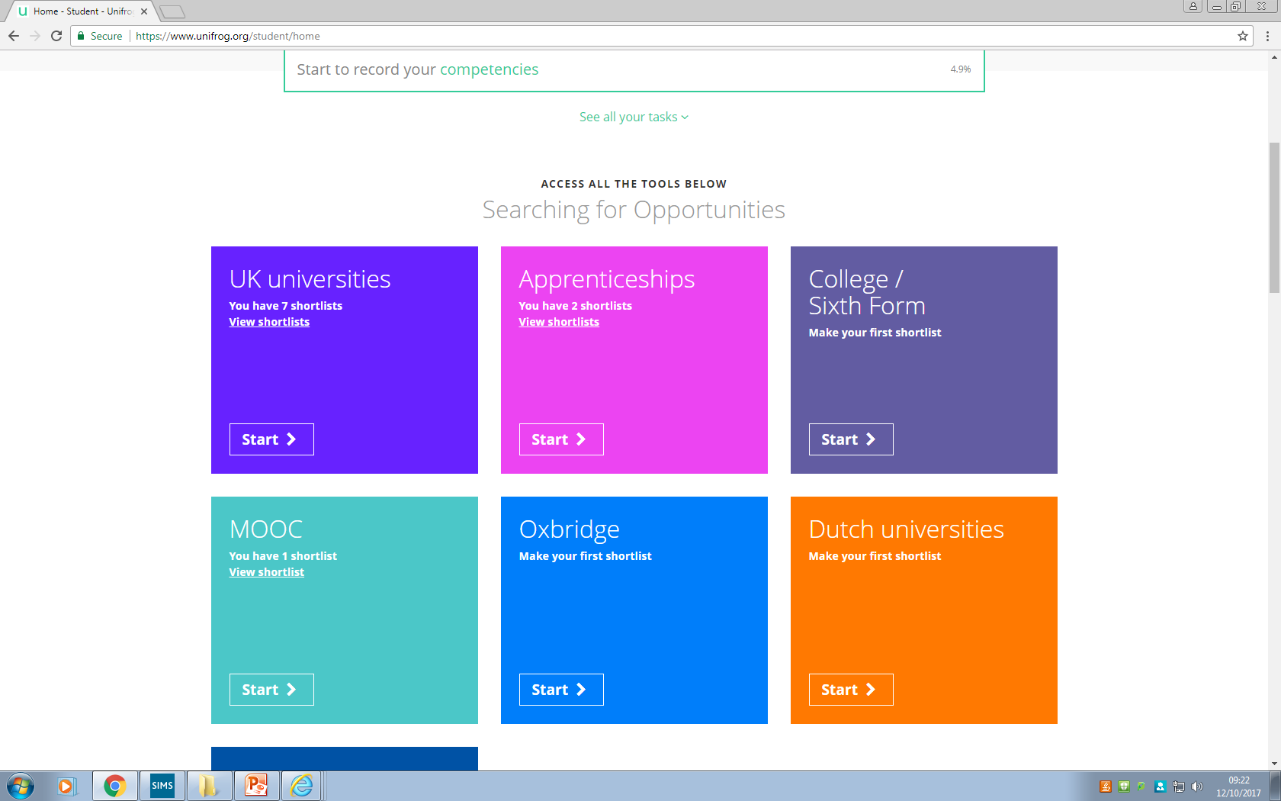
How to apply for an apprenticeship
Search for apprenticeships using Unifrog
Notes:
Speaker notes:
Due to demand from business and backing from the government Higher Apprenticeships are expanding. Apprentices’ opportunities for career progression are increasing with the expansion of Higher Apprenticeships (levels 4-7). Equivalent to a degree, more of these specialised and highly skilled Apprenticeships are being offered each year, giving individuals the chance to continue their professional development and realise their full potential.

Slide 13
Tips for applying for an apprenticeship
Investigate now – look at possibilities this year (use Unifrog, UCAS Hub, Pathways CTM, Amazing Apprenticeships)
Get your CV up to date (CV builder Unifrog)
Take up opportunities to build up your CV
Undertake work experience (inc. Virtual)
Apply early
Get interview experience
Attend Insight days
Strive for best grades in your A Level/BTEC qualifications

