Slide 1


_{Introduction} _{to student finance} ₂₀₂₆
https://www.gov.uk/student-finance

Slide 2
Please note: this information is only relevant for students applying for student finance for courses starting in September 2026. There are planned changes to the system for students applying later than this.
More information can be found here:
https://www.gov.uk/student-finance-on-or-after-1-january-2027

Slide 3


Section one: An introduction to student finance

Slide 4
What is student finance?
Student Finance England (SFE) provides financial support on behalf of
the UK Government to students from England entering higher education
in the UK.
The two main costs you’ll have while studying are tuition fees and
living costs.
There’s student finance available to help you with both.
Depending on your circumstances, you could also get extra financial help while you study.

Slide 5

https://www.youtube.com/watch?v=oxdF7fe8y10

Slide 6
There are two types of loans you can get from SFE. You can apply for and receive both loans!
- Tuition Fee Loan. This currently is a maximum of £9,790 per academic year (most universities charge this amount per year)
- Maintenance Loan. This varies depending on whether you live at home whilst studying, study in London and don’t live at home, or don’t live at home and study outside London.

Slide 7

Tuition fees
- You won’t have to pay any tuition fees up front.
- You can get a Tuition Fee Loan to cover the fee charged by your university to pay for lectures, seminars and university access.
- The amount you get doesn’t depend on your household income.
- SFE will pay the Tuition Fee Loan directly to your university.
- You’ll have to start paying your Tuition Fee Loan back when you’ve finished or left your course, but only if your income is over the repayment threshold.
- You must be eligible to apply for the Tuition Fee Loan.
Notes:
Private universities or colleges may charge a higher tuition fee. If they do, it’s up to you to pay the difference .

Slide 8

How can you be eligible?
1) The course must be at an eligible university in the UK (check with your uni if you are unsure) and cover:
- First degree, eg BA, BSc or BEd
- Foundation Degree
- Certificate of Higher Education
- Diploma of Higher Education (DipHE)
- Higher National Certificate (HNC)
- Higher National Diploma (HND)
- Initial Teacher Training (ITT)
- Integrated Masters
Note: the vast majority of UK universities are eligible!

Slide 9

2) You must meet national or residency status. All the following need to apply to you.
- You must be a UK national or Irish citizen or have “settled status”
- You must normally live in the UK
- You must have been living legally in the UK, Channel Islands or Isle of Man for 3 continuous years before the first day of your course
There are other residency situations which may make you eligible (see next slide) – if you are unsure, get in touch with SFE directly.

Slide 10
refugee (including family members)
humanitarian protection (including family members)
migrant worker or frontier worker from the EU, Switzerland, Norway, Iceland or Liechtenstein (including family members) with settled or pre-settled status
child of a Swiss national and they and their parent have settled or pre-settled status under the EU Settlement Scheme
child of a Turkish worker who has permission to stay in the UK - they and their Turkish worker parent must have been living in the UK by 31 December 2020
a stateless person (including family members)
an unaccompanied child granted ‘Section 67 leave’ under the Dubs Amendment
a child who is under the protection of someone granted ‘Section 67 leave’, who is also allowed to stay in the UK for the same period of time as the person responsible for them (known as ‘leave in line’)
granted ‘Calais leave’ to remain a child of someone granted ‘Calais leave’ to remain, who is also allowed to stay in the UK for the same period of time as their parent (known as ‘leave in line’)
they’ve been given settled status (‘indefinite leave to remain’) because they’ve been the victim of domestic violence
they’ve been given settled status (‘indefinite leave to remain’) as a bereaved partner
they or their family member have been granted leave under the Afghan Relocations and Assistance Policy (ARAP)
they or their family member have been granted leave to enter or remain in the UK under the Ukraine Family Scheme, the Homes for Ukraine Sponsorship Scheme or the Ukraine Extension Scheme

Slide 11
This chart shows you how the Tuition Fee loan is paid to your university.
The first payment is only paid by SFE when you have registered at your university.
This is when you first arrive and get your passes and room allocation.
Payment | % of total amount | Amount paid
1 | 25% | £2,447.5
2 | 25% | £2,447.5
3 | 50% | £4,895
 | Total amount paid | £9,790

Slide 12

How is the tuition fee loan repaid?
You will have to repay this loan, but repayments don’t usually start until the April after you finish your course
You will start to repay when your annual income is over £25,000 BEFORE tax and deductions. If at any point you stop earning over this, you stop repaying until your income is higher than this again.
Repayments depend on your income, usually 9% on earnings over the £25,000 threshold. (more info on this in section 3)
You will be charged interest on this loan from the first day a payment is made. This rate is based on RPI.

Slide 13
Student loan repayments. You will be on Plan 5. This may be different to older siblings
Income each year before tax | Monthly income before tax | 9% will be deducted from | Monthly repayment (Approx)
£25 000 | £ 2083 | 0 | £0
£28 000 | £2333 | £250 | £22.5
£29,500 | £2458 | £375 | £33.75
£31,000 | £2583 | £500 | £45
£33,000 | £2750 | £667 | £60

Slide 14

Maintenance Loan
You can get a Maintenance Loan to help with your living costs, such as rent.
- All eligible students can get some maintenance support.
- The amount you can get depends on your household income, and where you live and study.
- You can also apply for more based on your household income.
- The maintenance loan is paid directly into your bank account at the start of each term.
- You’ll have to start paying your maintenance loan back when you’ve finished or left your course, but only if your income is over the repayment threshold.
Notes:
The basic rate of Maintenance Loan doesn’t depend on household income but you can apply for more that does.

Slide 15

For the academic year 2026/7 maximum amounts are
Parental home
Live at home while you study
Up to
£9,118
London
Live away from home & study in London
Up to
£14,135
Living away from home
Outside of London
Up to
£10,830
Notes:
Click image to link to page!

Slide 16
How are you paid?
Maintenance Loans are paid directly to you three times a year, normally around the start of each term.
You must have a UK bank or building society account in your own name and you’ll need to register at your university or college before you can receive your first payment.

Slide 17

Is there any other financial support?
Yes! This may be available if you:
- Have a disability, including a long-term health condition, mental-health condition or specific learning difficulty.
- Many universities also offer bursary payments - contact them directly to find out more.
https://www.gov.uk/extra-money-university-college-study

Slide 18


Section 2 - How to apply for student finance
- This is done online. When you start the application you will be asked to prove your identity. This is your valid UK passport details.
If you don’t have a valid UK passport then you may have to send evidence, by post, to SFE. You will also need your NI number and bank details.
The other piece of information you will need is your household income if you are applying for the maintenance loan
Your household income includes:
- your parents’ income, if you live with them or depend on them financially
- the combined income of one of your parents and their partner, if you live with them or depend on them financially
Apply online (GOVUK website) : Applications open on Monday 23rd March https://www.gov.uk/apply-online-for-student-finance

Slide 19
Section 2 - Applying

Slide 20
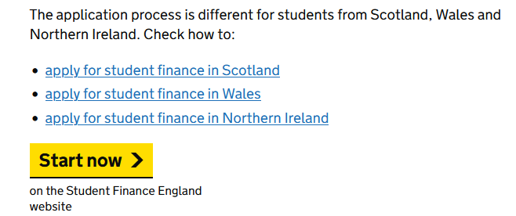
Apply online at https://www.gov.uk/apply-online-for-student-finance

Slide 21
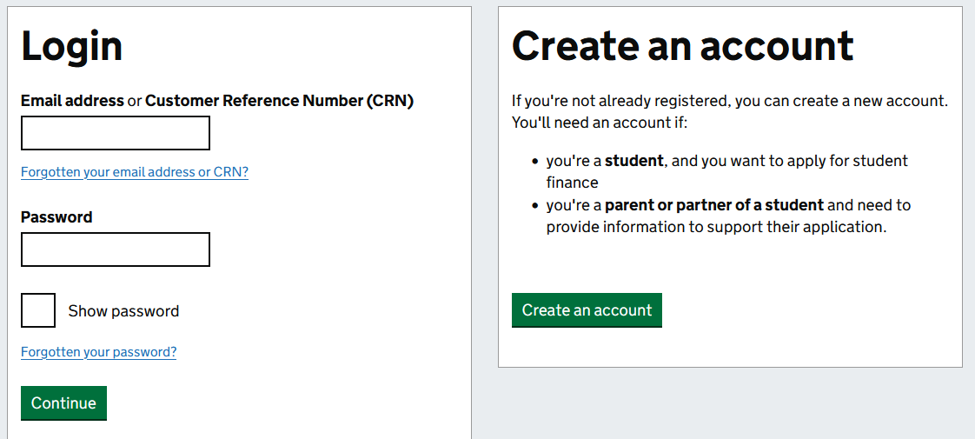
Clicking start takes you to this page.
Notes:
Click image to link to page!

Slide 22

Your parents or carers will need to support your application if you are applying for the part of the maintenance loan that is means assessed
They will need their own email account to register on SFE to support the application.
Should this not be possible then paper forms are available.

Slide 23
Section 3 – Repaying your student loan

Slide 24

Student loan repayments
- You won’t make repayments until your income is over the repayment threshold.
- If you study a full-time course, you will be due to start repaying in the April after graduating or leaving your course.
- You’ll repay 9% of your income over the threshold.
- If your income falls below the threshold, your repayments will stop.
- You do not make repayments manually. They will automatically be taken from your monthly salary.
- Any outstanding loan balance will be cancelled 40 years after entering repayment.

Slide 25
Section 4 – further advice

Slide 26

https://www.youtube.com/watch?v=3FiErJEQop4

Slide 27

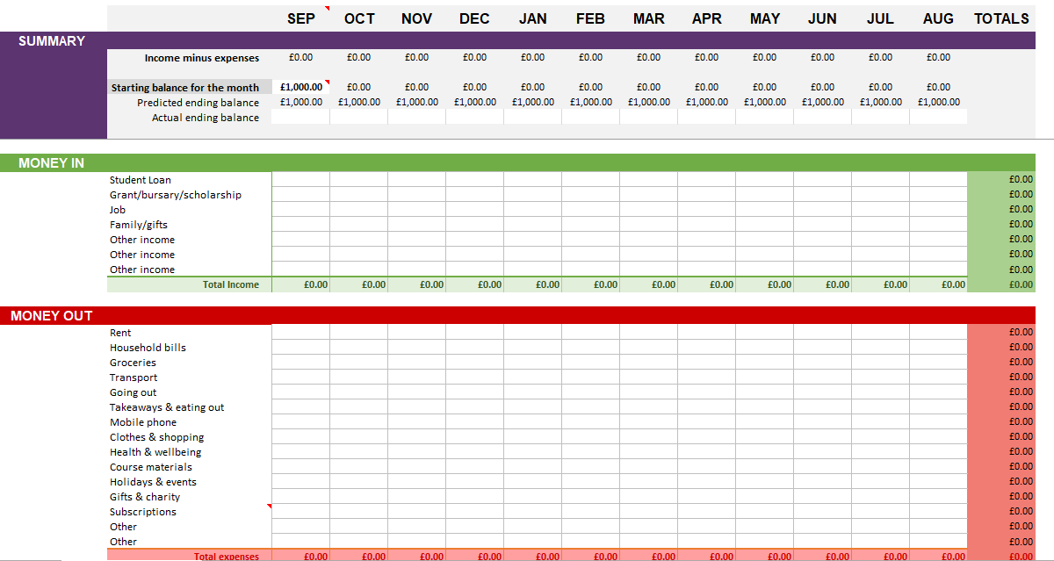
Concerned about budgeting at Uni? Planning is key!
Lets see what Martin Lewis thinks
https://www.moneysavingexpert.com/students/student-budgeting-planner/
https://www.savethestudent.org/money/student-budgeting/student-budgeting.html

Slide 28
Both Martin Lewis and Save the Student have loads of ideas and tips for budgeting and more crucially special offers and tips to reduce outgoings.
Martin Lewis always updates in July/August when banks are trying to persuade you to switch to them and companies are offering student deals. Keep an eye out, throughout the year he has news you can use.
Save The Student also updates regularly.
How to budget at university: https://www.youtube.com/watch?v=BCWfWmbpiEQ

Slide 29
Helpful links:
Student Finance England youtube channel: often posts step-by-step guides. https://www.youtube.com/@SFEFILM/videos
Gov UK SFE: Application guidance. Also where you should formally apply. https://www.gov.uk/get-undergraduate-student-loan
UCAS Student Finance information: https://www.ucas.com/money-and-student-life/money/student-finance/student-finance-england
UCAS Scholarships and Bursaries search tool: https://www.ucas.com/explore/search/scholarships-and-bursaries?query=
Follow Student Finance England on Instagram for updates: @studentfinance_england

