Slide 1


Where can studying Engineering take you?
Highlighting the relevance of Engineering to future careers and opportunities

Slide 2

What pathways can you take with this subject?
What do you think these roles involve (daily task, etc.)?
Why Engineering
matters
What careers can you think of that use Engineering?
Have you ever considered where studying Engineering can take you?
Today, we’ll be exploring some of
the career opportunities that are available to you, as well as the various pathways you can take to get there.
Why is Engineering an
important subject?
An example of why Engineering matters
- YouTube
What skills do you think you might need for these roles?

Slide 3
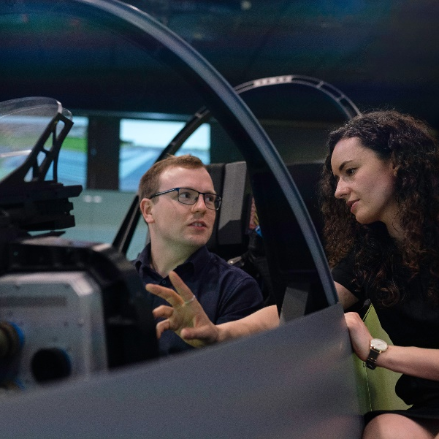



Aerospace Engineer
BBC Bitesize case study
Explore a career as a…
neon case study
neon case study
Biomedical Engineer
Here are some example roles and careers linked to
Engineering
neon case study
neon case study
neon case study
Robotics Engineer
BBC Bitesize case study
neon case study
neon case study

Slide 4

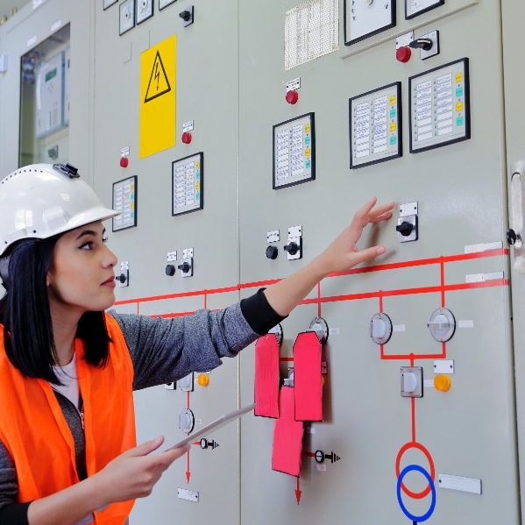

Marine Engineer
BBC Bitesize case study
Explore a career as a…
neon case study
neon case study
Electrical Engineer
Here are some example roles and careers linked to
Engineering
neon case study
BBC Bitesize case study
BBC Bitesize case study
Civil Engineer
BBC Bitesize case study
neon case study
BBC Bitesize case study

Slide 5
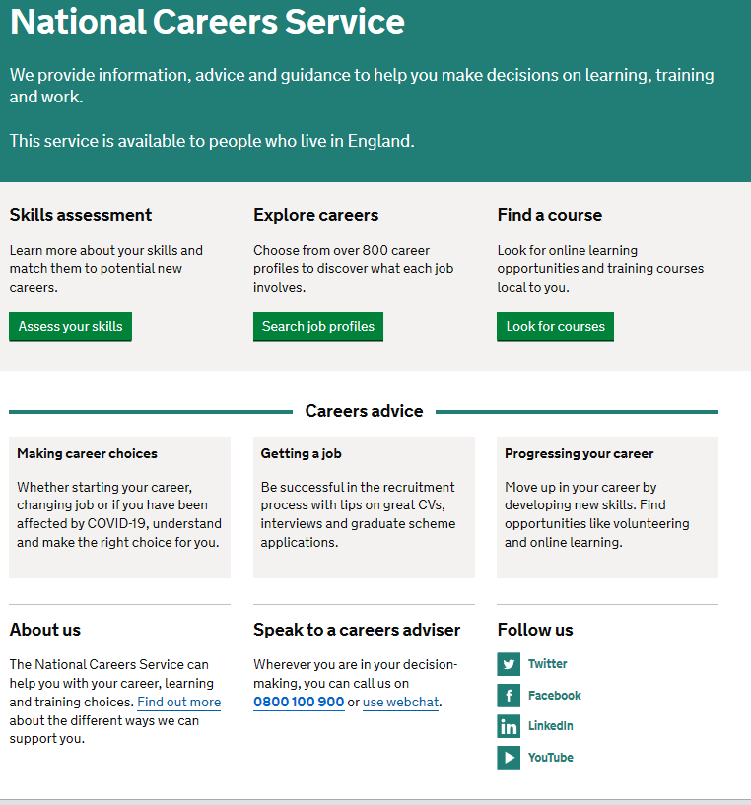
Discover more about the role
Explore careers using National Careers Service and find out about what jobs involve and how they are right for you
Includes:
Average salary
Typical hours
Work patterns
Pathways/How to become
Essential Skills
Daily tasks
Career path and progression
Current opportunities
Research Ideas:
Aerospace Engineer
Biomedical/Clinical Engineer
Robotics Engineer
Marine Engineer
Electrical Engineer
Civil Engineer

Slide 6


GCSE
While there are different routes you can take to be a teacher there are a few essential things that you will need:
• A minimum GCSE Grade 4 or above in English and maths (plus science if you want to teach primary)
A degree or equivalent qualification
A level
T Level
Vocational/Technical Qualification
Apprenticeship
A levels are 2 years of study
T Levels are nationally recognised, technical qualifications for 16–19-year-olds. Designed by leading employers, one T Level is equivalent in size to 3 A levels
These include BTEC, Applied General Qualifications (AGQ) and Vocational Technical Qualifications (VTQ) – all at Level 3
Apprenticeships are jobs which combine practical work and study. Intermediate is Level 2, Advanced is Level 3
Degree
Level 4/5 qualifications
Higher apprenticeships
Complete a degree course
It is possible to get QTS as part of an undergraduate degree, for example:
• Bachelor of Arts (BA) with QTS
• Bachelor of Education (BEd) with QTS
• Bachelor of Science (BSc) with QTS
Complete a L4/5 course and top up to a degree – L4/5 includes Certificate of HE, Diploma of HE, Higher Technical Qualification (HTQ), HNC, HND and Foundation degrees
Top up to a degree (Level 6) in a year of full-time study
Higher level apprenticeship (foundation degree / Level 5)
Degree apprenticeships
Degree apprenticeship
(Level 6-7). There is a Level 6 Teaching apprenticeship programme
Initial Teacher Training (ITT) with qualified teacher status (QTS)
Teacher

Slide 7


