Slide 1


Where can studying History take you?
Highlighting the relevance of History to future careers and opportunities

Slide 2

What pathways can you take with this subject?
What do you think these roles involve (daily task, etc.)?
Why History matters
What careers can you think of that use History?
Have you ever considered where studying History can take you?
Today, we’ll be exploring some of
the career opportunities that are available to you, as well as the various pathways you can take to get there.
Why is History an
important subject?
How will History help me? MYPATH - YouTube
What skills do you think you might need for these roles?

Slide 3
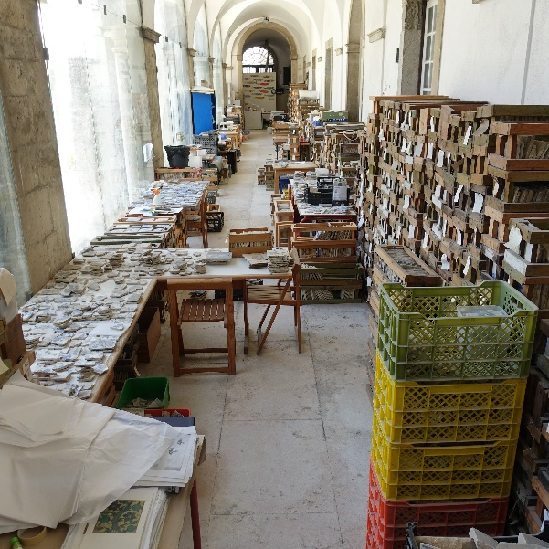



Museum Curator
icould case study
icould case study
Explore a career as a…
Prospects case study
Here are some example roles and careers linked to
History
Research Manager/Data Analyst
BBC Bitesize case study
Prospects case study
Paralegal
BBC Bitesize case study

Slide 4



Conservation Officer
Explore a career as a…
icould case study
Prospects case study
Lawyer/Solicitor
Here are some example roles and careers linked to
History
icould case study
icould case study
Prospects case study
Broadcast Journalist
BBC Bitesize case study
Prospect case study

Slide 5
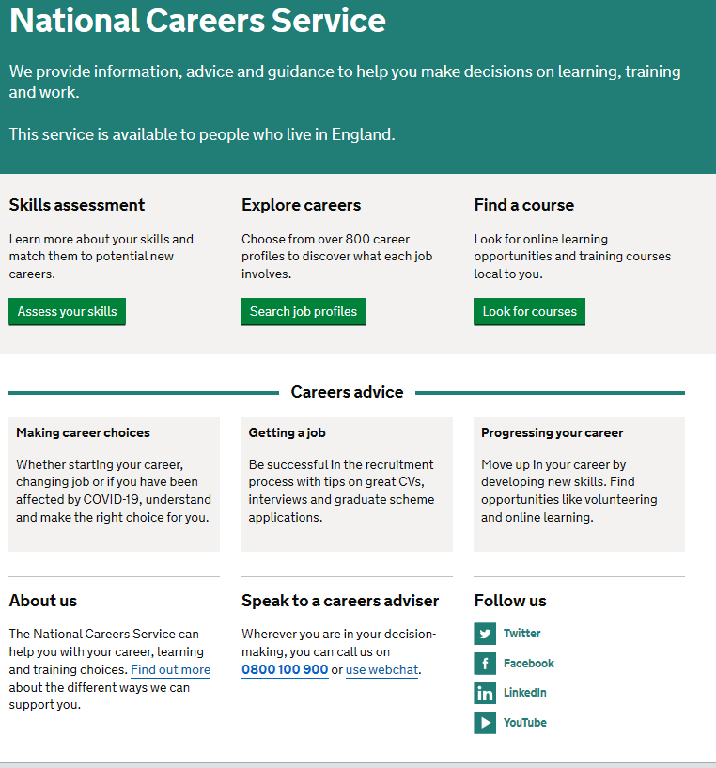
Discover more about the role
Explore careers using National Careers Service and find out about what jobs involve and how they are right for you
Includes:
Average salary
Typical hours
Work patterns
Pathways/How to become
Essential Skills
Daily tasks
Career path and progression
Current opportunities
Research Ideas:
Museum Curator
Market Research Data Analyst
Paralegal
Conservation Officer
Solicitor
Broadcast Journalist

Slide 6

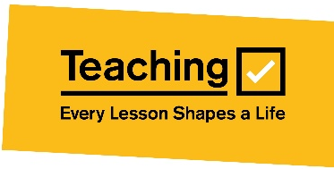
GCSE
While there are different routes you can take to be a teacher there are a few essential things that you will need:
• A minimum GCSE Grade 4 or above in English and maths (plus science if you want to teach primary)
A degree or equivalent qualification
A level
T Level
Vocational/Technical Qualification
Apprenticeship
A levels are 2 years of study
T Levels are nationally recognised, technical qualifications for 16–19-year-olds. Designed by leading employers, one T Level is equivalent in size to 3 A levels
These include BTEC, Applied General Qualifications (AGQ) and Vocational Technical Qualifications (VTQ) – all at Level 3
Apprenticeships are jobs which combine practical work and study. Intermediate is Level 2, Advanced is Level 3
Degree
Level 4/5 qualifications
Higher apprenticeships
Complete a degree course
It is possible to get QTS as part of an undergraduate degree, for example:
• Bachelor of Arts (BA) with QTS
• Bachelor of Education (BEd) with QTS
• Bachelor of Science (BSc) with QTS
Complete a L4/5 course and top up to a degree – L4/5 includes Certificate of HE, Diploma of HE, Higher Technical Qualification (HTQ), HNC, HND and Foundation degrees
Top up to a degree (Level 6) in a year of full-time study
Higher level apprenticeship (foundation degree / Level 5)
Degree apprenticeships
Degree apprenticeship
(Level 6-7). There is a Level 6 Teaching apprenticeship programme
Initial Teacher Training (ITT) with qualified teacher status (QTS)
Teacher

Slide 7



