Slide 1
Where can studying Textiles take you?
Highlighting the relevance of Textiles to future careers and opportunities

Slide 2
What pathways can you take with this subject?
What do you think these roles involve (daily task, etc.)?
Why Textiles matters
What careers can you think of that use Textiles?
Have you ever considered where studying Textiles can take you?
Today, we’ll be exploring some of the career opportunities that are available to you, as well as the various pathways you can take to get there.
Why is Textiles an important subject?
What can you do with a Textile Design degree?
Birmingham City university - YouTube
What skills do you think you might need for these roles?

Slide 3
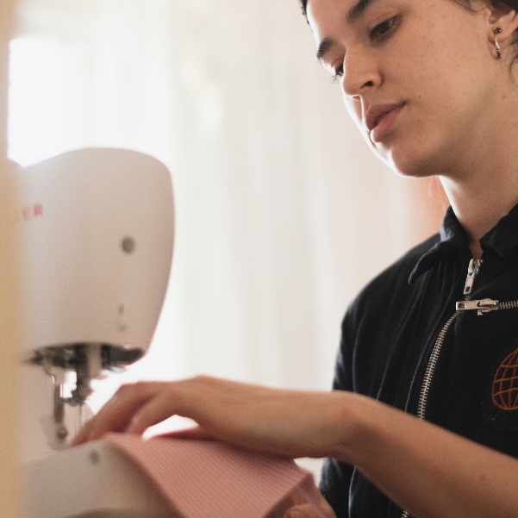
Designer
Craftscouncil case study
Explore a career as a…
BBC Bitesize case study
BBC Bitesize case study
Here are some example roles and careers linked to Textiles
Garment Technologist
UKft case study
BBC Bitesize case study
Retail Buyer
BBC Bitesize case study

Slide 4
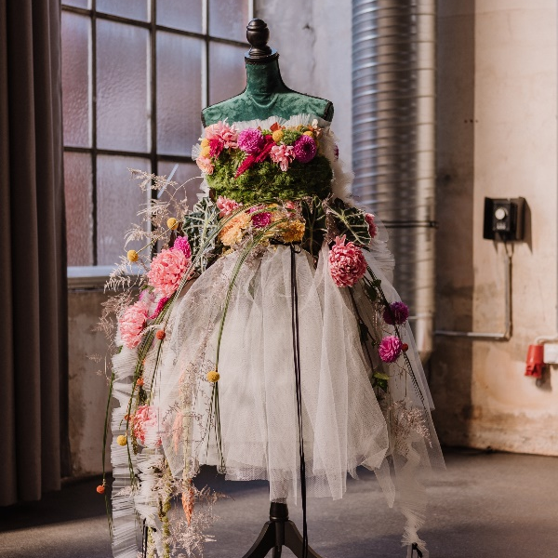
Explore a career as a…
Costume Designer
BBC Bitesize case study
Getintotheatre case study
Textiles Operative
Here are some example roles and careers linked to Textiles
icould case study
UKft case study
Marketing Executive
BBC Bitesize case study
Discovercreative case study

Slide 5
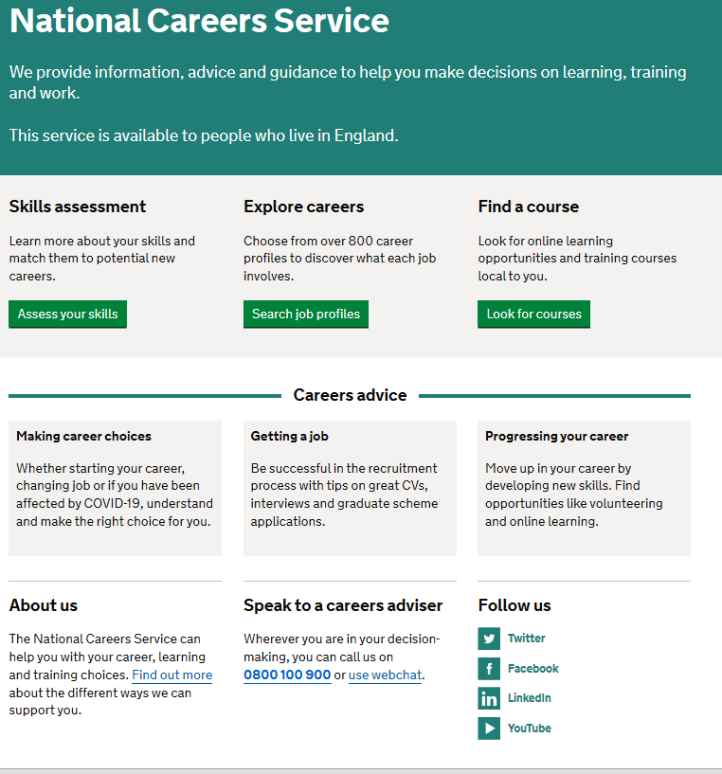
Discover more about the role
Explore careers using National Careers Service and find out about what jobs involve and how they are right for you
Includes:
Average salary
Typical hours
Work patterns
Pathways/How to become
Essential Skills
Daily tasks
Career path and progression
Current opportunities
Research Ideas:
Fashion Designer
Garment Technologist
Retail Buyer
Costume Designer
Textiles Operative
Marketing Executive

Slide 6
GCSE
While there are different routes you can take to be a teacher there are a few essential things that you will need:
• A minimum GCSE Grade 4 or above in English and maths (plus science if you want to teach primary)
A degree or equivalent qualification
A level
T Level
Vocational/Technical Qualification
Apprenticeship
A levels are 2 years of study
T Levels are nationally recognised, technical qualifications for 16–19-year-olds. Designed by leading employers, one T Level is equivalent in size to 3 A levels
These include BTEC, Applied General Qualifications (AGQ) and Vocational Technical Qualifications (VTQ) – all at Level 3
Apprenticeships are jobs which combine practical work and study. Intermediate is Level 2, Advanced is Level 3
Degree
Level 4/5 qualifications
Higher apprenticeships
Complete a degree course
It is possible to get QTS as part of an undergraduate degree, for example:
• Bachelor of Arts (BA) with QTS
• Bachelor of Education (BEd) with QTS
• Bachelor of Science (BSc) with QTS
Complete a L4/5 course and top up to a degree – L4/5 includes Certificate of HE, Diploma of HE, Higher Technical Qualification (HTQ), HNC, HND and Foundation degrees
Top up to a degree (Level 6) in a year of full-time study
Higher level apprenticeship (foundation degree / Level 5)
Degree apprenticeships
Degree apprenticeship
(Level 6-7). There is a Level 6 Teaching apprenticeship programme
Initial Teacher Training (ITT) with qualified teacher status (QTS)
Teacher

