Slide 1
Where can studying Mathematics take you?
Highlighting the relevance of Mathematics to future careers and opportunities

Slide 2
What pathways can you take with this subject?
What do you think these roles involve (daily task, etc.)?
Why Mathematics matters
What careers can you think of that use Mathematics?
Have you ever considered where studying Mathematics can take you?
Today, we’ll be exploring some of the career opportunities that are available to you, as well as the various pathways you can take to get there.
Why is Mathematics an
important subject?
5 great reasons to study maths - Success at School
What skills do you think you might need for these roles?

Slide 3
Senior Systems Engineer
BBC Bitesize case study
Explore a career as a…
Financial trader/ Stockbroker
Here are some example roles and careers linked to
Mathematics
Prospect case study
icould case study
Quantity Surveyor
BBC Bitesize case study
icould case study

Slide 4
Accounting Technician
Explore a career as a…
BBC Bitesize case study
Prosects case study
Games Designer
Here are some example roles and careers linked to
Mathematics
BBC Bitesize case study
Prospects case study
BBC Bitesize case study
Sales Associate
icould case study

Slide 5
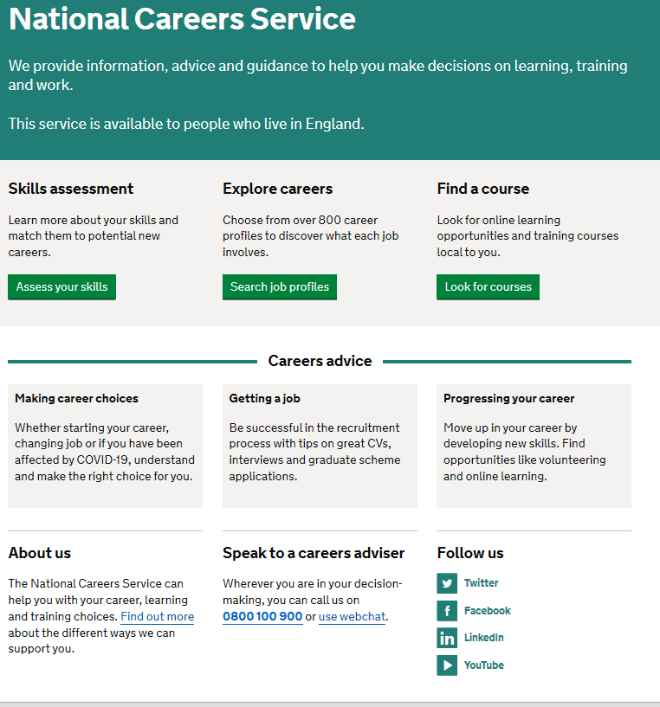
Discover more about the role
Explore careers using National Careers Service and find out about what jobs involve and how they are right for you
Includes:
Average salary
Typical hours
Work patterns
Pathways/How to become
Essential Skills
Daily tasks
Career path and progression
Current opportunities
Research Ideas:
Senior Systems Engineer
Stockbroker
Quantity Surveyor
Accounting Technician
Games Designer
Sales Associate

Slide 6
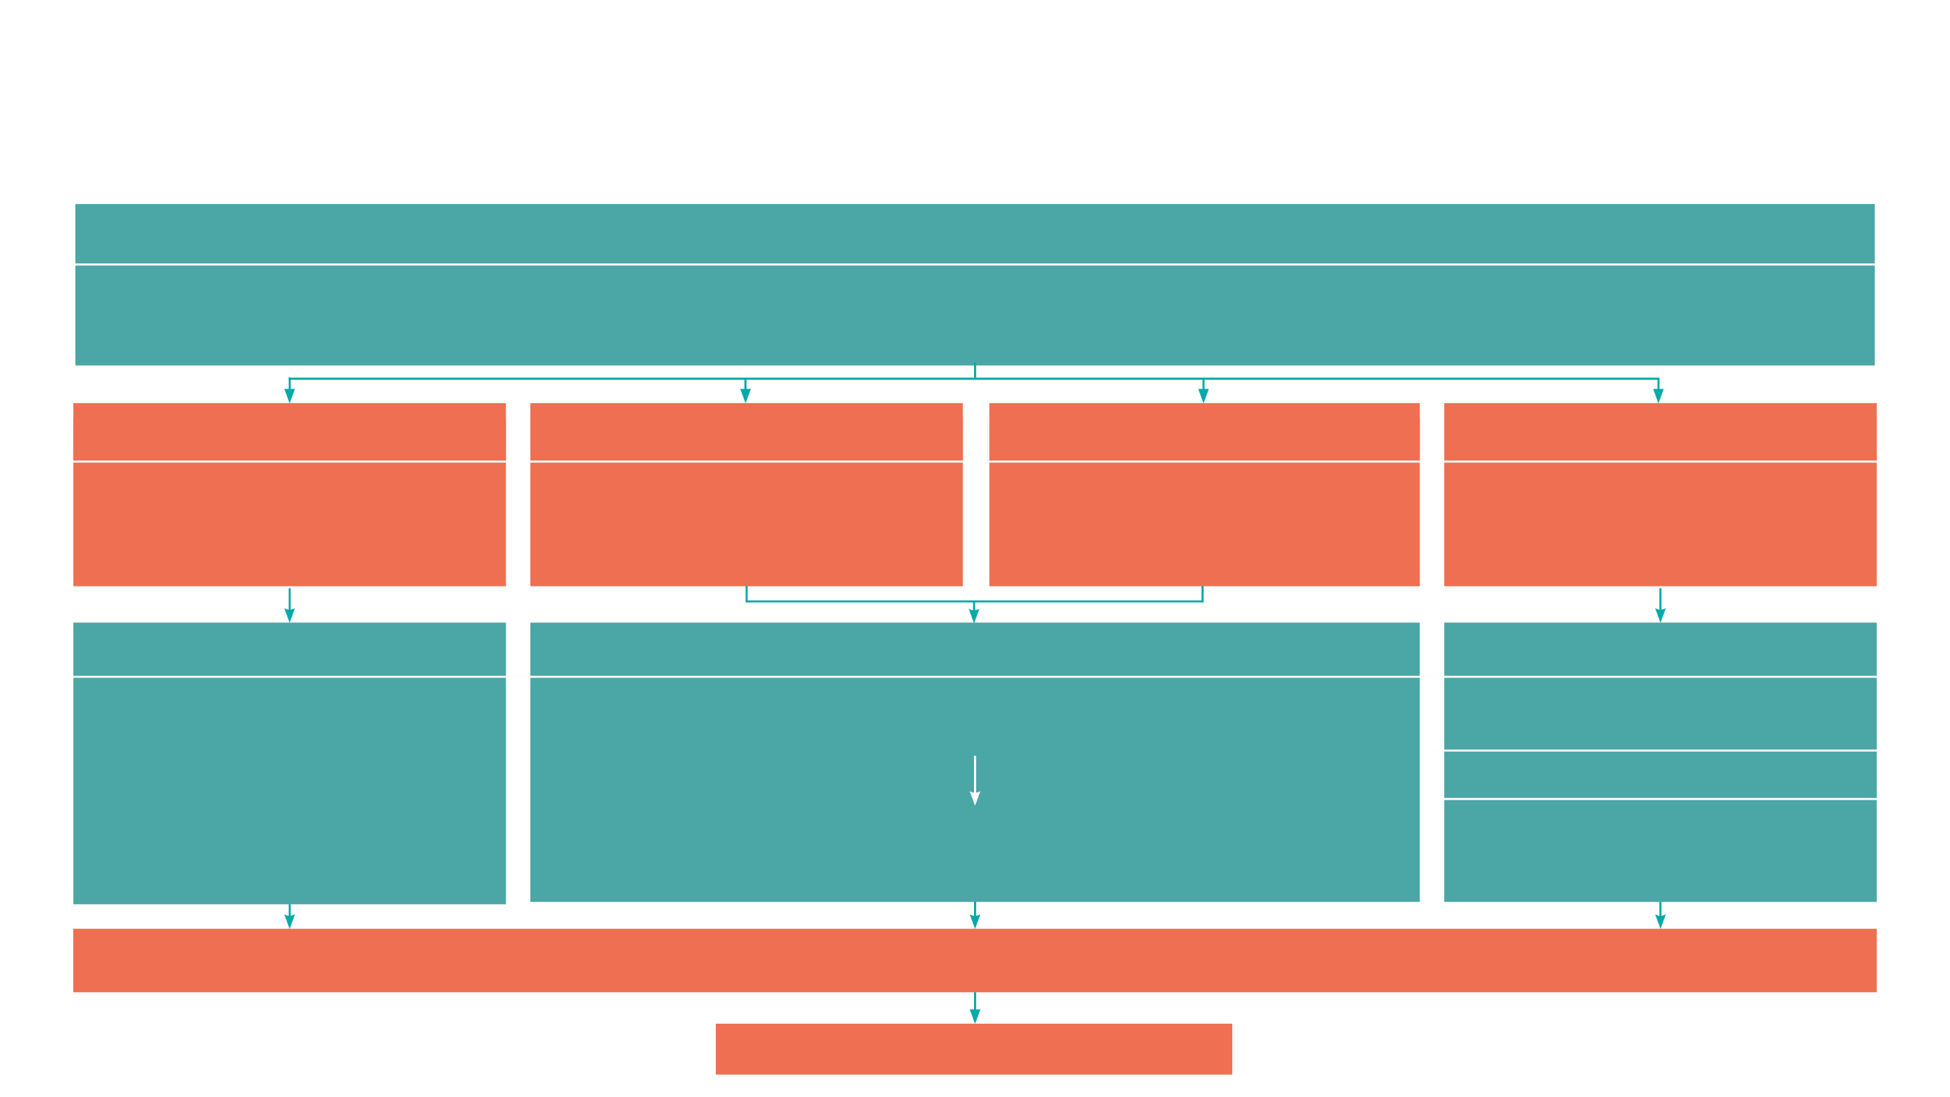
GCSE
While there are different routes you can take to be a teacher there are a few essential things that you will need:
• A minimum GCSE Grade 4 or above in English and maths (plus science if you want to teach primary)
A degree or equivalent qualification
A level
T Level
Vocational/Technical Qualification
Apprenticeship
A levels are 2 years of study
T Levels are nationally recognised, technical qualifications for 16–19-year-olds. Designed by leading employers, one T Level is equivalent in size to 3 A levels
These include BTEC, Applied General Qualifications (AGQ) and Vocational Technical Qualifications (VTQ) – all at Level 3
Apprenticeships are jobs which combine practical work and study. Intermediate is Level 2, Advanced is Level 3
Degree
Level 4/5 qualifications
Higher apprenticeships
Complete a degree course
It is possible to get QTS as part of an undergraduate degree, for example:
• Bachelor of Arts (BA) with QTS
• Bachelor of Education (BEd) with QTS
• Bachelor of Science (BSc) with QTS
Complete a L4/5 course and top up to a degree – L4/5 includes Certificate of HE, Diploma of HE, Higher Technical Qualification (HTQ), HNC, HND and Foundation degrees
Top up to a degree (Level 6) in a year of full-time study
Higher level apprenticeship (foundation degree / Level 5)
Degree apprenticeships
Degree apprenticeship
(Level 6-7). There is a Level 6 Teaching apprenticeship programme
Initial Teacher Training (ITT) with qualified teacher status (QTS)
Teacher

Slide 7
Study Pathways
7|
A levels A levels | National Careers Service
You might find courses in:
• Mathematics • Further Mathematics
HTQs (Higher Technical Qualifications) Higher technical qualifications (HTQs) | National Careers Service
You might find courses in:
• Mathematics • Accounting and Finance • Aeronautical Engineering • Accounting
• Statistics • Statistical Problem Solving using Software
• Economics • Accounting
Higher education Higher education | National Careers Service You can explore undergraduate courses in Mathematics
You might find courses in:
• Actuarial Mathematics • Accounting • Mathematics • Accounting and Finance • Aeronautical Engineering
• General Engineering​
• Finance, Investment and Risk ​ • Agri-Business Management ​ • Accounting with data Science ​ • Accounting with Economics​ • Accounting and Law​
• Banking and Finance

