Slide 1
Where can studying Drama take you?
Highlighting the relevance of Drama to future careers and opportunities

Slide 2
What pathways can you take with this subject?
What do you think these roles involve (daily task, etc.)?
Why Drama matters
Have you ever considered where studying Drama can take you?
Today, we’ll be exploring some of the career opportunities that are available to you, as well as the various pathways you can take to get there.
What careers can you think of that use Drama?
Why is Drama an
important subject?
Why Drama matters
- National Drama
What skills do you think you might need for these roles?

Slide 3
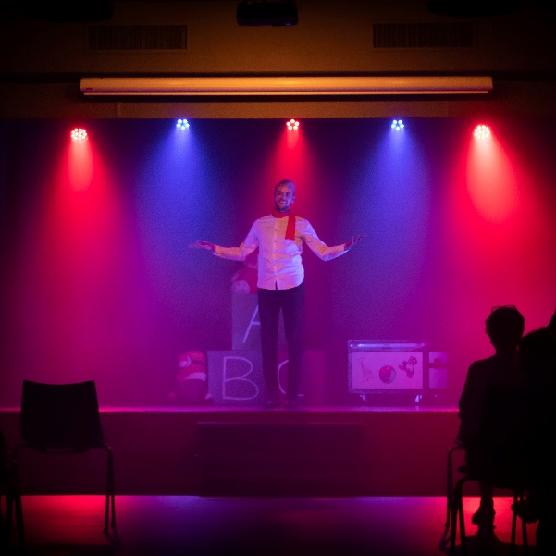
Comedian
BBC Bitesize case study
Explore a career as a…
BBC Bitesize case study
Drama Facilitator/ Therapist
Here are some example roles and careers linked to
Drama
BBC Bitesize case study
NHS case study
Lighting Technician
BBC Bitesize case study
BBC Bitesize case study

Slide 4
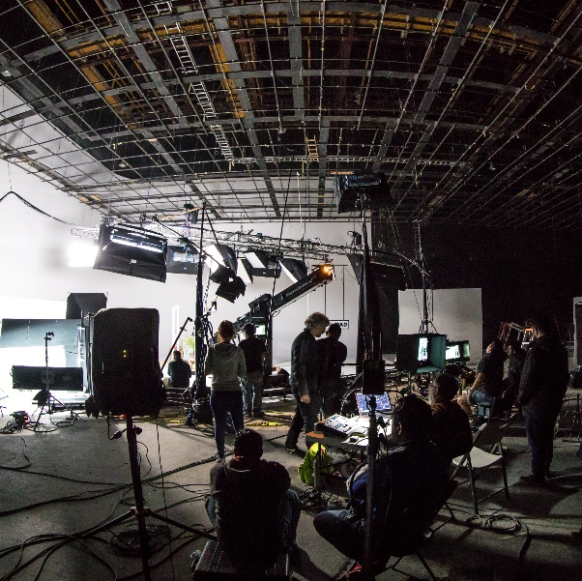
Actor
BBC Bitesize case study
Explore a career as a…
BBC Bitesize case study
Production/Stage Manager
Here are some example roles and careers linked to
Drama
BBC Bitesize case study
BBC Bitesize case study
BBC Bitesize case study
Production Assistant
BBC Bitesize case study

Slide 5
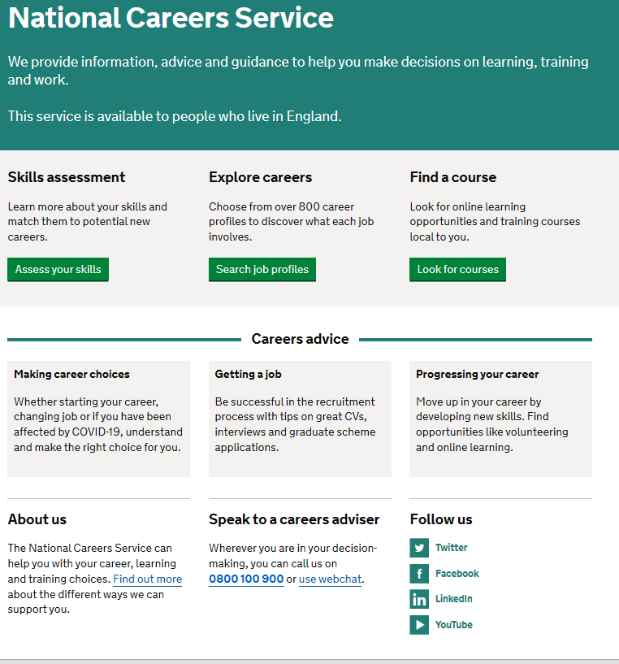
Discover more about the role
Explore careers using National Careers Service and find out about what jobs involve and how they are right for you
Includes:
Average salary
Typical hours
Work patterns
Pathways/How to become
Essential Skills
Daily tasks
Career path and progression
Current opportunities
Research Ideas:
Entertainer
Drama Facilitator/Therapist
Lighting Technician
Actor
Production/Stage Manager
Production Assistant

Slide 6
GCSE
While there are different routes you can take to be a teacher there are a few essential things that you will need:
• A minimum GCSE Grade 4 or above in English and maths (plus science if you want to teach primary)
A degree or equivalent qualification
A level
T Level
Vocational/Technical Qualification
Apprenticeship
A levels are 2 years of study
T Levels are nationally recognised, technical qualifications for 16–19-year-olds. Designed by leading employers, one T Level is equivalent in size to 3 A levels
These include BTEC, Applied General Qualifications (AGQ) and Vocational Technical Qualifications (VTQ) – all at Level 3
Apprenticeships are jobs which combine practical work and study. Intermediate is Level 2, Advanced is Level 3
Degree
Level 4/5 qualifications
Higher apprenticeships
Complete a degree course
It is possible to get QTS as part of an undergraduate degree, for example:
• Bachelor of Arts (BA) with QTS
• Bachelor of Education (BEd) with QTS
• Bachelor of Science (BSc) with QTS
Complete a L4/5 course and top up to a degree – L4/5 includes Certificate of HE, Diploma of HE, Higher Technical Qualification (HTQ), HNC, HND and Foundation degrees
Top up to a degree (Level 6) in a year of full-time study
Higher level apprenticeship (foundation degree / Level 5)
Degree apprenticeships
Degree apprenticeship
(Level 6-7). There is a Level 6 Teaching apprenticeship programme
Initial Teacher Training (ITT) with qualified teacher status (QTS)
Teacher

