Slide 1
Year 13
Parent Information Evening

Slide 2
Results
A Level | A* | A*/A | A*/B | A*/C | A*/D
2025 | 3.3% | 13% | 50.2% | 80.1% | 95%
2024 | 0.4% | 8.3% | 43% | 74% | 93%
BTEC | D* | D*/D | D*/M
2025 | 6% | 46% | 87%
2024 | 6% | 39% | 86%

Slide 3
University Courses 2025
Digital Media and Communication
Sport and Exercise Science
Accounting and Finance with a Year in Industry
Art Direction For Fashion (Accelerated Degree)
Real Estate
Paramedic Science BSc
Law with Psychology
History
Sociology
Events Management
Engineering and Technology with Foundation Year
Mathematics with a Year in Industry
Marketing
Primary Education with Qualified Teacher Status [QTS] (5-11)*
Social Sciences, Arts & Humanities with Foundation Year
Biomedical Engineering including a Foundation Year
Fine Art
Midwifery
Physiotherapy
Nursing Studies (Registered Nurse Adult Nursing)
Business Management with Law
Criminology and Sociology
Law
Nursing with Registration as a Children’s Nurse
Computing and Management (with placement)
English Literature
Psychology
Geography
Chemistry
Planetary Exploration with Astronomy
Drama: Musical Theatre
Biomedical Science
Midwifery
Economics
Film & Television Production

Slide 4
Class of 2025 - Universities
University of Birmingham
Keele University
Loughborough University
University of Reading
Goldsmiths, University of London
Rose Bruford College
University of Chichester
King's College London, University of London
Nottingham Trent University
London South Bank University
Birkbeck, University of London
University of Brighton
Queen Mary University of London
SOAS University of London
University of Essex
University of York
SOAS University of London
University of Kent
University of Portsmouth
University of Nottingham
University of Winchester
Brunel University of London
Norwich University of the Arts
Oxford Brookes University
University of Leicester
City St George's, University of London
University of Surrey
University of East London
Manchester Metropolitan University
University of Liverpool
Fashion Retail Academy
University of Westminster, London
University of Greenwich
University of Hertfordshire
Royal Holloway, University of London

Slide 5
Apprenticeships/Jobs 2025
Business operations analyst in asset servicing in Euroclear comapny
Apprenticeship in Production Control at Classified Central Media
Apprenticeship at Parkway Primary School as an LSA
HR Job at Jaguar
Admin Assistant at Riverside Financial Consulting
Police Constable Apprenticeship Level 6
MEP Digital Engineering Apprenticeship with Laing O’Rourke (level 6)
Maples group Law company (Job)
Apprenticeship at Zurich Insurance in Retail/Distribution
Apprenticeship at MHA in Accounting
Apprenticeship at KPMG Level 6 Tax Audit
Apprenticeship at Balfour Beatty in Civil Engineering
Apprenticeship in Construction Quantity Surveying
Electrician Apprenticeship
Junior Clerk at Doughty Street Chambers
Apprenticeship in Civil/Structural Engineer Level 6
Level 7 Apprenticeship at Price Bailey in Accountancy
Job with Accredited training at Gallagher in Insurance (CII Certificate in Insurance)
Apprenticeship in Recruitment
Apprenticeship at Munich Re in Insurance

Slide 6
“As children get older, parental encouragement for, and interest in, their children’s learning are more important than direct involvement.”
EEF

Slide 7
Where do you want to be?
GCSE APS 4.56 - ALPS Target grades CCC MMD-
Student 1 BBC
Student 2 AB Dist*
Student 3 Dist Dist Dist
Student 4 BC Dist
Student 5 EED
Student 6 CC Dist
Notes:
What stands out to you?
Average GCSE score – highest 8.11 to put into context

Slide 8
Timetables
Study centre
Learning Zone
Form Time
Morning Mentoring
Exams 2026

Slide 9
Independent Study
Research has shown that successful students spend four or five hours per subject per week outside of lessons completing independent study.
Students aiming for A*/A grades do 25+ hours a week outside of lessons
Make Good Habits

Slide 10
Independent study sessions
Reviewing lesson notes
Using PLCs
Completing exam questions (past papers/samples)
Using exam board mark schemes
Using examiners reports
Improving a piece of work
Revision guides/work books
Preparing UCAS application/CV
Wider reading
On-line courses
Book-a-mock

Slide 11
Assessment
Predicted grades (references)
BTEC (year 12 grades)
Progress updates (Termly)
Half Term graded work (summative assessment)
Coursework
Pre-Public Examinations (PPE)
BTEC External units (exams)

Slide 12
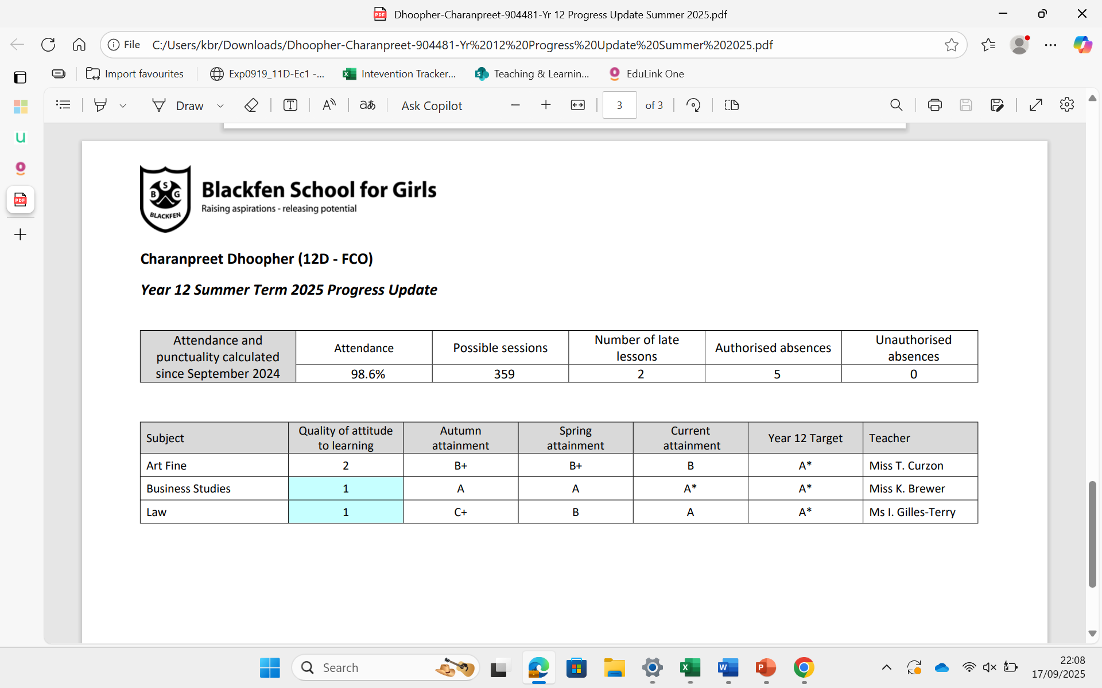
Progress updates

Slide 13
UCAS Grade Tariff
Grade | A Level | EPQ | BTEC | BTEC
A* | 56 | 28 | Dist.* | 56
A | 48 | 24 | Dist. | 48
B | 40 | 20
C | 32 | 16 | Merit | 32
D | 24 | 12
E | 16 | 8 | Pass | 16

Slide 14
Next Steps support:
https://teams.microsoft.com/v2/

Slide 15
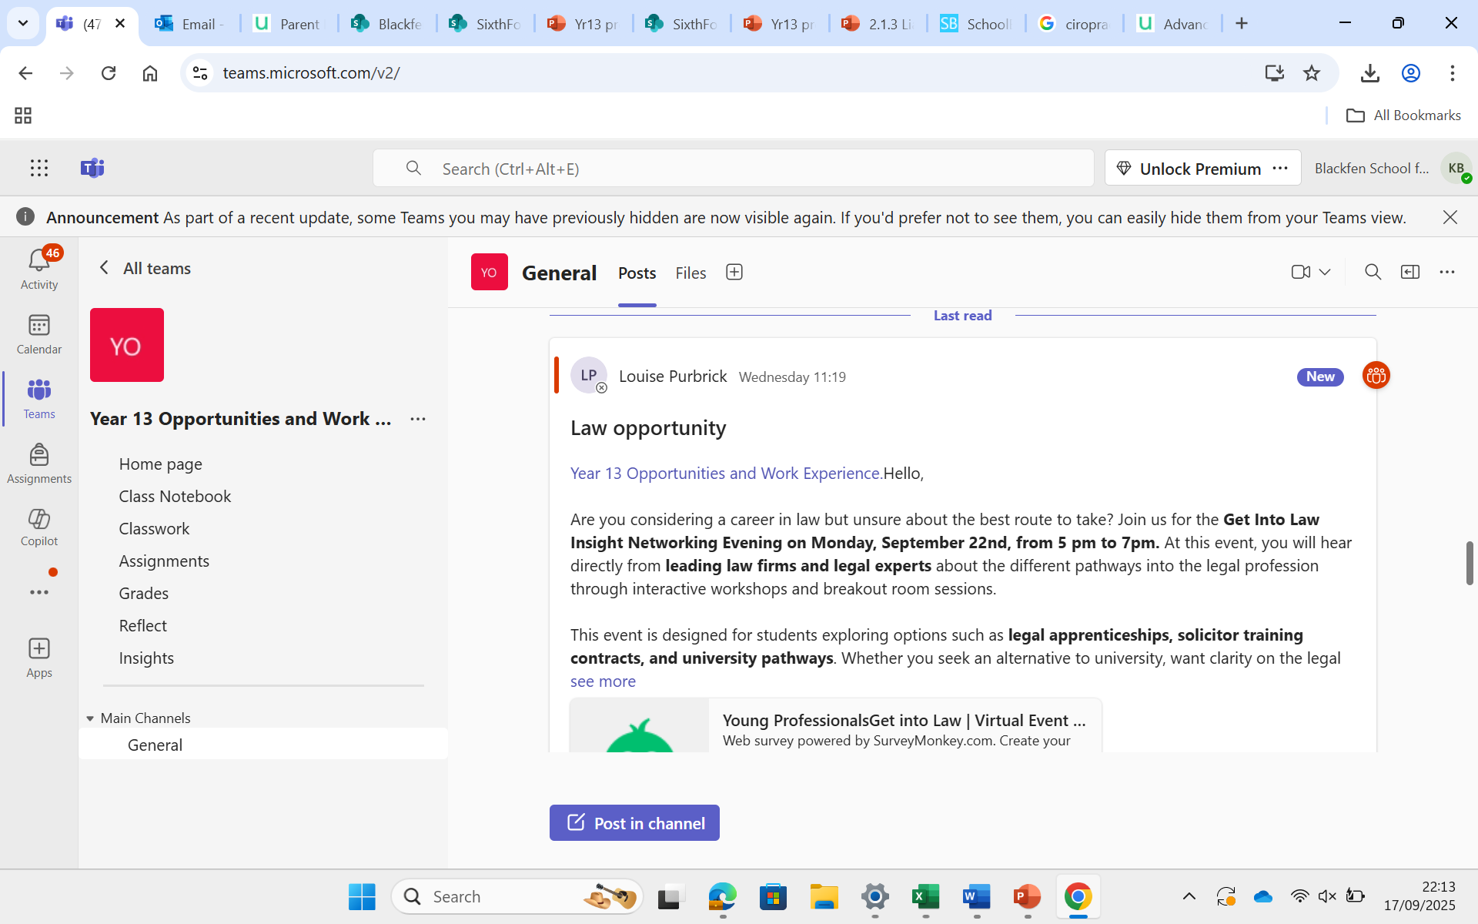

Slide 16
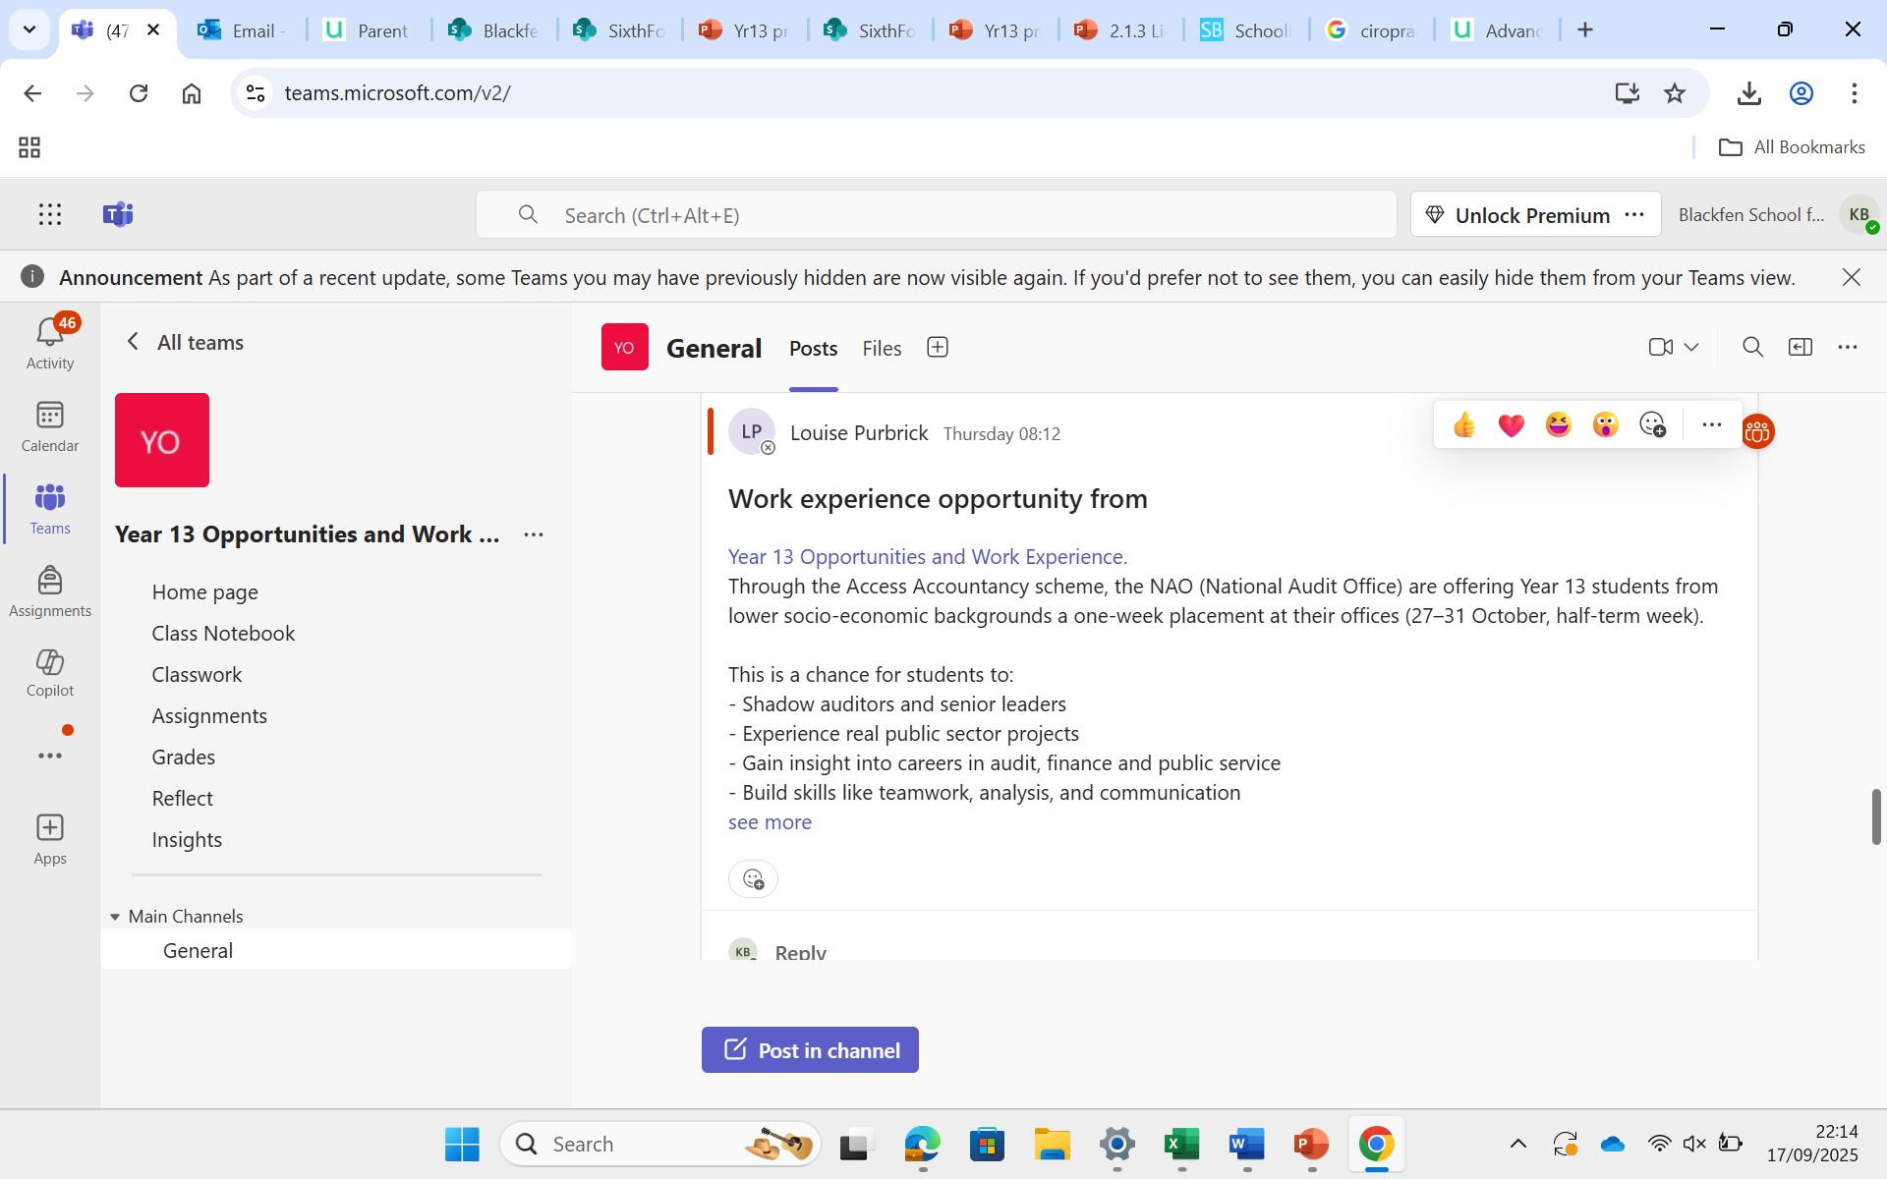

Slide 17
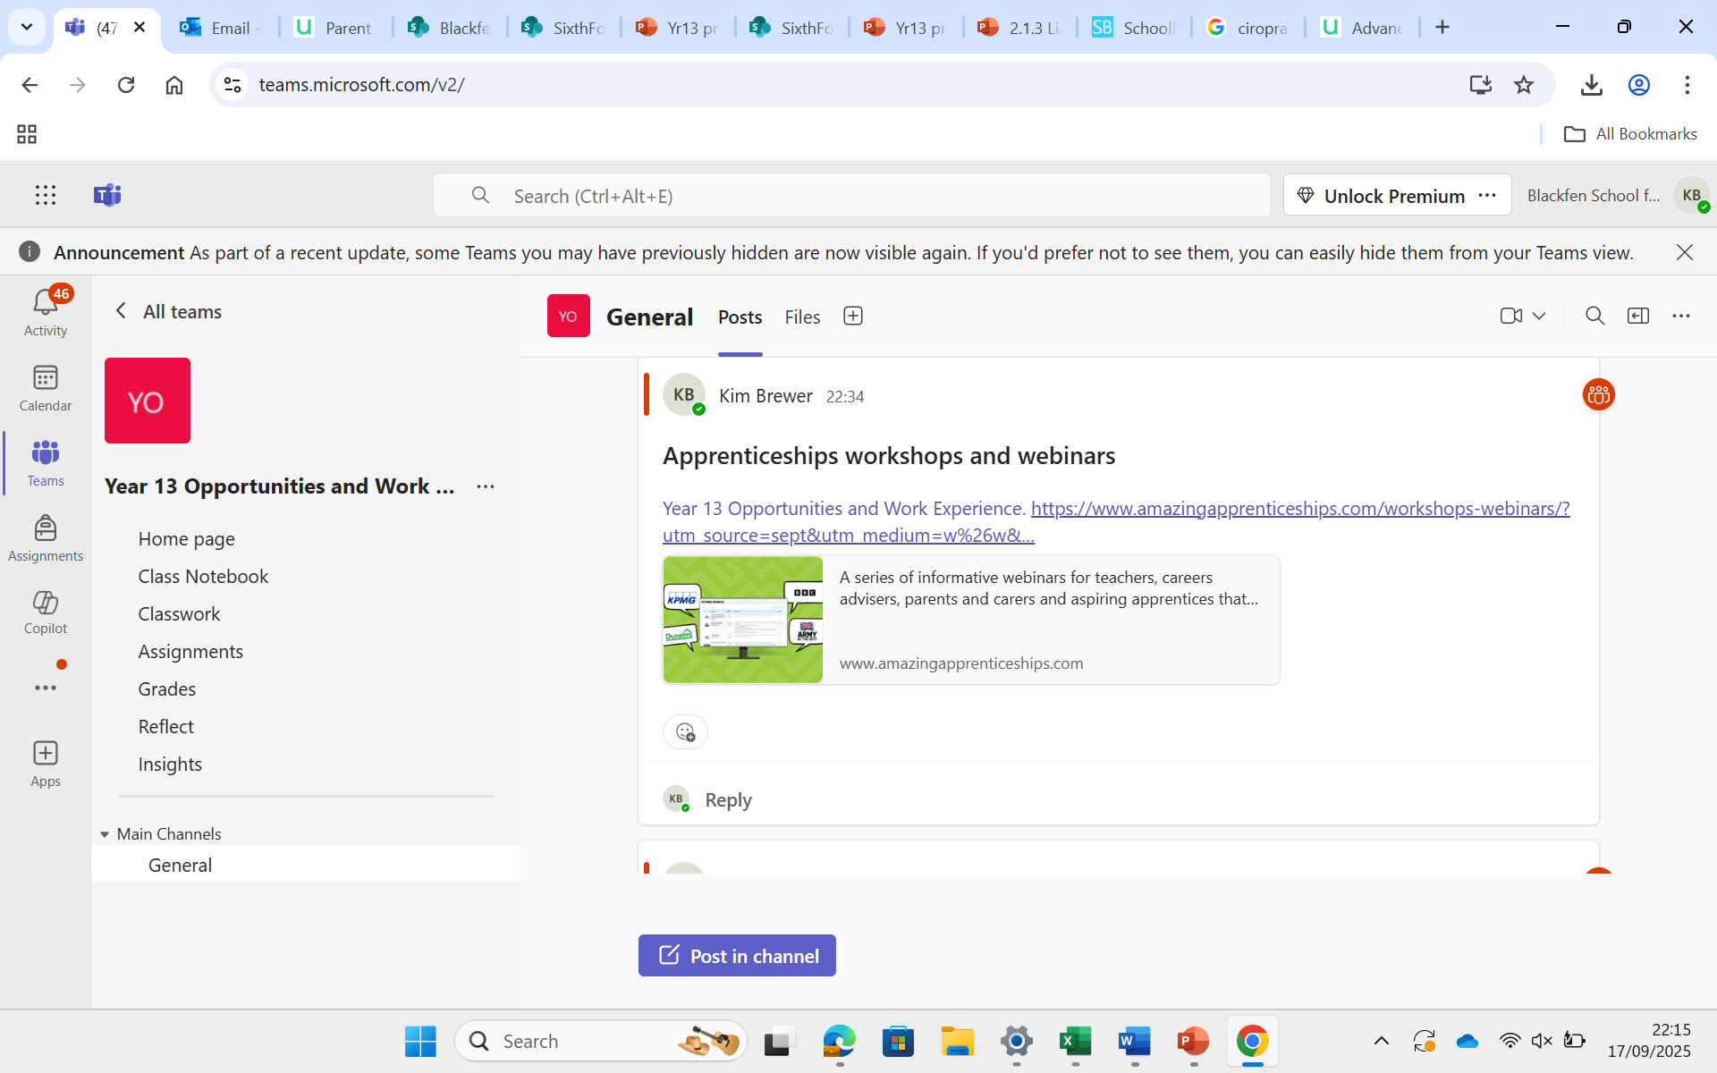

Slide 18

Post-18
https://www.unifrog.org/student/home

Slide 19
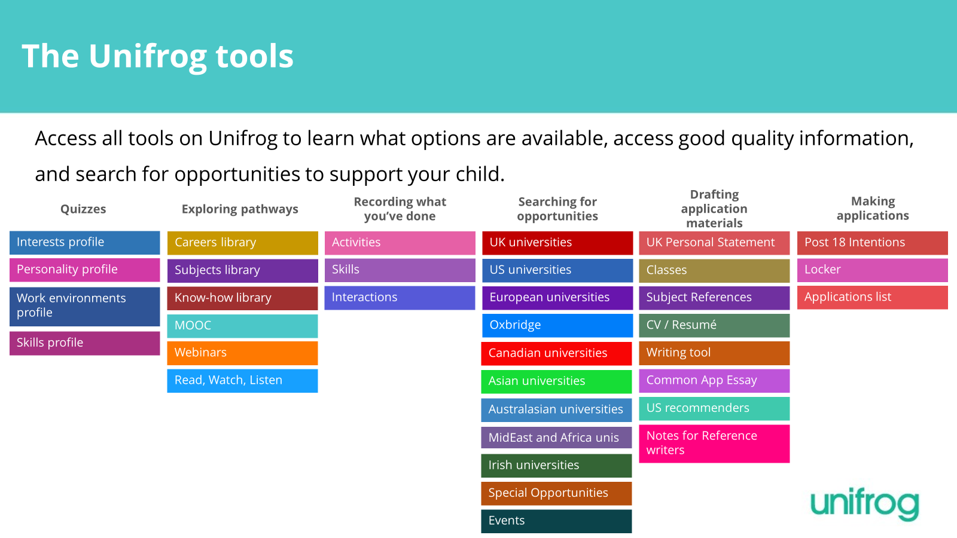

Slide 20
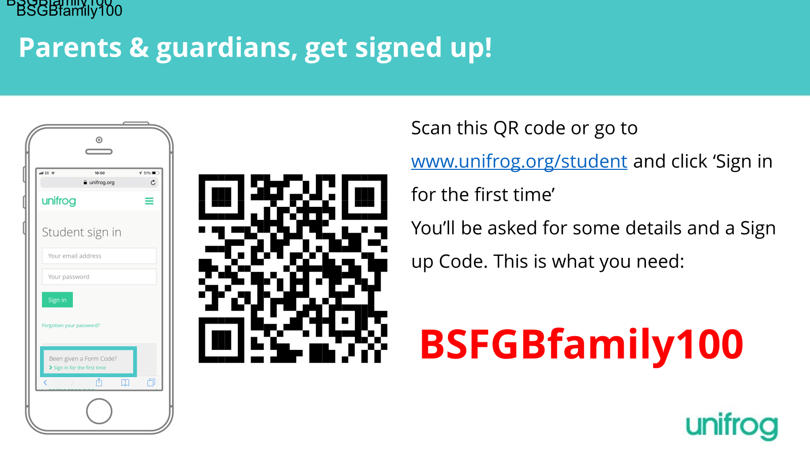

Slide 21
Ensuring success:
High expectations
Effective study habits
Limit part time work hours
100% Attendance
Time management
Parental involvement/support
Preparation for after Sixth Form

Slide 22
UCAS
Personal statements – workshop Thursday 25th 4.30 – 7.00
Application process
Applying for Finance

Slide 23
Useful websites
Mental Health and Wellbeing
Rise above www.riseabove.org.uk
Headscape http://headscapebexley.co.uk/
Young Minds www.youngminds.org.uk
Bexley IASS: https://www.bexleyiass.co.uk/your-wellbeing-16-25-years-of-age/
MHST – self referral

Slide 24
Links
Virtual work experience:
Springpod: https://www.springpod.com/virtual-work-experience
TED Talks: https://www.ted.com/talks
Future Learn: https://www.futurelearn.com
Unifrog: https://www.unifrog.org/
UCAS: https://www.ucas.com/

Slide 25
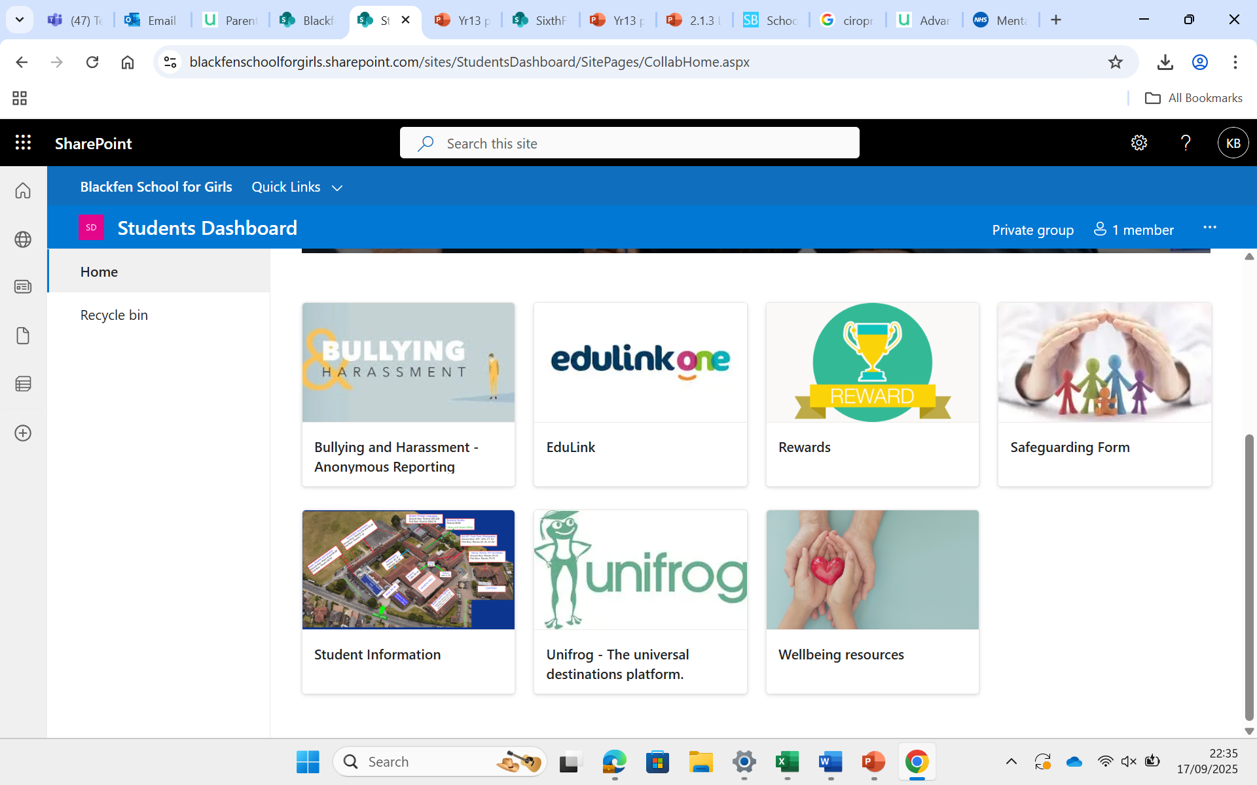

Slide 26
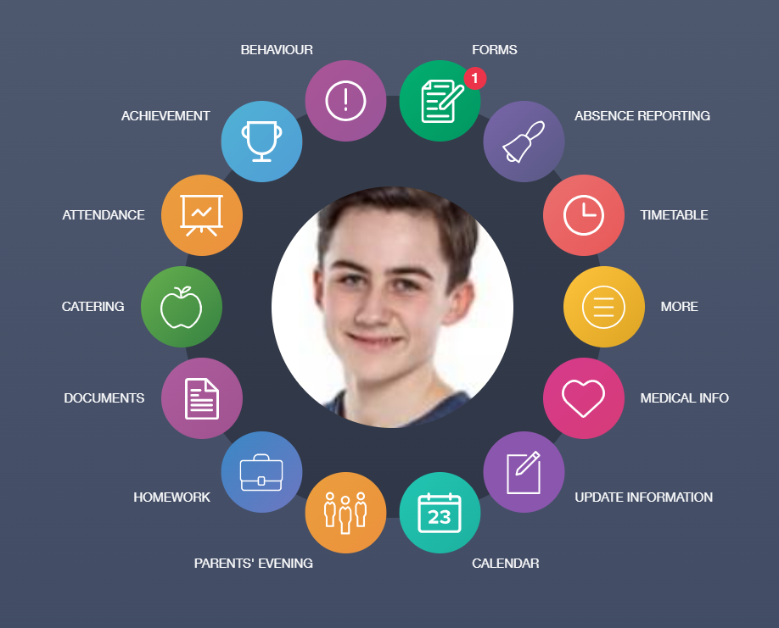
https://www.edulinkone.com/#!/

Slide 27
Important Dates
October/Nov UCAS applications sent off
w/b 3rd November PPEs (A Level and BTEC)
^{4th} December Year 13 Parent evening
w/b 5th January Start of BTEC exam period
January Apprenticeship application period starts
w/b 9th Feb PPE (A Level)
March/April Final university offers
April/May Complete student finance (university students)
27th March-12th April Easter Holidays
May 11th A Level exam period starts.
13th August A Level & BTEC results.

Slide 28


Slide 29
