Slide 1

‘Next Steps’
Information evening

Slide 2
This evening….
Applying for University (UCAS)
Apprenticeships
Student Finance
Support for Blackfen students
EPQ

Slide 3
Choices available
Higher education
Apprenticeships/ traineeships
Studying abroad
Gap year
Getting a job
Find out more: ucas.com
Security marking: PUBLIC
11 March 2026
| 3

Slide 4
Applying to University

Slide 5
University of Manchester | History
Queen Mary University of London | Biochemistry
University of Birmingham | Biochemistry, Medical
Queen Mary University of London | Pharmacology and Innovative Therapeutics
Lancaster University | Law
Birmingham City University | Law with Criminal Justice
University of Greenwich | Criminology and Criminal Psychology
University of Brighton | Nursing (Adult)
University of Bath | Chemistry for Drug Discovery with Industrial Placement
Norwich University of the Arts | Photography
Queen Mary University of London | Psychology with a Year Abroad
Keele University | Neuroscience and Psychology
University of Greenwich | Primary Education with Qualified Teacher Status
University of Sheffield | Politics
St Mary's University, Twickenham | History
Ulster University | Law
University of Liverpool | Criminology
University of Portsmouth | Photography
Birmingham City University | Mental Health Nursing (September) with Foundation Year
University of Southampton | Finance and Financial Technology with Placement Year
University of Sussex | Psychology
University of Derby | Midwifery
University of Westminster, London | Business Management
University of the Arts London | Interior and Spatial Design
De Montfort University | Law LLB
Canterbury Christ Church University | Sport & Exercise Science
University of Kent | Film
Kingston University | Primary Teaching (QTS)
University of Greenwich | Sociology and Criminology
University of Essex | Speech and Language Therapy
Lancaster University | Politics and International Relations
University of Greenwich | Criminology and Criminal Psychology
University of Kent | Psychology
Lancaster University | Law
Arts University Bournemouth | Fine Art
University of Greenwich | Primary Education with Qualified Teacher Status
University of Portsmouth | Business and Management
University of East Anglia UEA | Chemistry with a Foundation Year
University of Portsmouth | Criminology and Cybercrime
University of Brighton | Psychology and Criminology
University of Roehampton | Sociology
University of East London | Interior Design
University of Brighton | Environmental Management
University of Warwick | Law and Sociology
De Montfort University | Law LLB
Brunel University London | Sport, Health and Exercise Sciences (Physical Ed
Northumbria University, Newcastle | Graphic Design
University of Essex | Psychosocial and Psychoanalytic Studies
University of Kent | Accounting and Finance with a year in Industry
University of Kent | Law
De Montfort University | Animation
Canterbury Christ Church University | Applied Criminology
University of Greenwich | Equine Training and Management
University of Roehampton | Sociology
Nottingham Trent University | Psychology
Kingston University | Real Estate Management with Professional Placement Year
Northumbria University, Newcastle | International Relations and Politics
University of Portsmouth | Marine Biology
University of Greenwich | Business Management
Nottingham Trent University | Business
Coventry University | Law
University of the Arts London | Hair and Make-up for Fashion
University of Roehampton | Psychology & Counselling
University of Greenwich | Business Management

Slide 6
UCAS – an independent charity
UCAS does:
process applications
provide information, advice, and training
have a Fraud and Verification Team
take part in education sector engagement
UCAS doesn’t:
suggest courses or universities
make decisions or offers
advise on finance, immigration, or visas for individuals
Security marking: PUBLIC
11 March 2026
| 6
Notes:
6

Slide 7
What is UCAS?
350+ universities and colleges:
  4 in Northern Ireland
  15 in Wales
  18 in Scotland
  316 in England
35,000+ courses available
Security marking: PUBLIC
11 March 2026
| 7

Slide 8
Why higher education?
Opportunities while studying:
Chance to study a subject they are passionate about.
Achieve a qualification that could lead to their chosen career.
Grow in confidence, make lifelong friends, and gain independence and important life skills that will widen their prospects.
With a degree, they’ll have:
  the opportunity to follow their career path
  better job prospects, as many employers target graduates
  higher earning potential
Security marking: PUBLIC
11 March 2026
| 8

Slide 9
Choosing the right university
Style – from the traditional, with a focus on subject-based courses and research, to modern universities, with a greater focus on vocational courses.
Location – some are based in large cities, others in smaller towns - a major influence on the environment and lifestyle.
Size – larger universities can have more than 20,000 students, whereas some of the smallest have only a few thousand.
Culture and facilities – influenced by a range of factors, including the diversity of students who attend.
What graduates do – all universities collect destination statistics. It can be interesting to find out the types of jobs or further study students go on to.
Tuition fees – can vary between course providers. Check if there are any scholarships or bursaries available.
Living costs – accommodation, transport, and food can vary enormously.
Security marking: PUBLIC
11 March 2026
| 9

Slide 10
Choosing the right course
What does the course cover?
Courses with the same title may be very different.
Look carefully at the core course content, and the range of optional studies/modules available.
Which modules are the most interesting and relevant to career aspirations?
See if the course or university/college offers any internship, placement, or study abroad opportunities.
How is the course taught – structured teaching, or more independent research? How many lectures are there, and how much group work will be done in seminars?
How is the course assessed?
Security marking: PUBLIC
11 March 2026
| 10

Slide 11
Research resources

Slide 12
Applying - key facts
May – UCAS opens for applications
September 2026 – Students can start submitting application to UCAS
Students can add up to 5 choices, unless they’re applying to study medicine, veterinary, medicine/science, dentistry – then it’s 4 choices
Students can’t apply to BOTH Oxford and Cambridge
Applying costs £28.95 (fee waived for FSM students)
Apply by the equal consideration date: January
Providers can’t see other choices when you apply

Slide 13
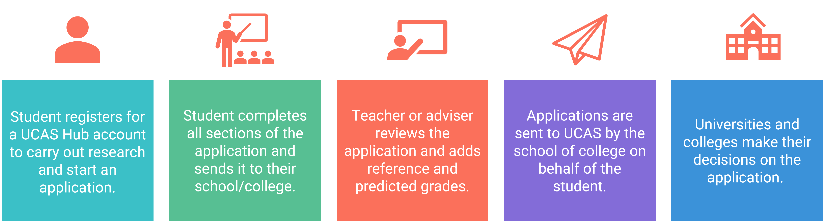
Completing the ucas application
Public
Notes:
It also means the school/college or centre can provide you with a reference and send your application to UCAS on your behalf.

Slide 14

What should students be doing now?
Check if entrance test is required
Research – use UNIFROG
Super curricular activities
Work experience
Attend Open Days and taster courses
Go beyond the syllabus
Focus on this year’s studies
Security marking: PUBLIC
11 March 2026
| 14

Slide 15
Unifrog
https://www.unifrog.org/student/home

Slide 16
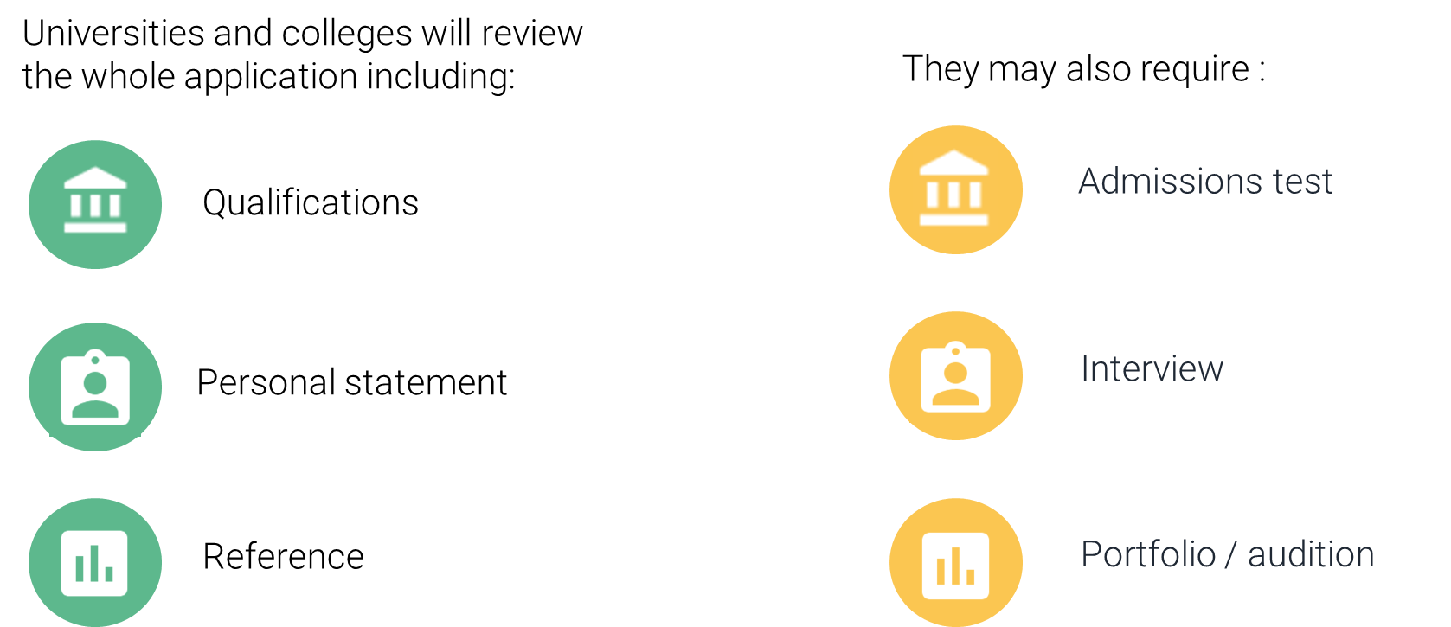
Decisions
Public
Notes:
The universities and colleges begin their decision-making process. This differs between them, and even for different courses at the same university or college. The application forms are viewed holistically, each section is important and will be used by universities and colleges in different ways – this is why is it so important for students to do detailed research to know what is being looked for by each choice. There may even be differences across individual universities in how they are used.
Most admissions tests happen between August and November the year before you're due to start your studies. Some have a registration deadline before you need to submit your UCAS application. You should check the UCAS course search to check whether the course you are applying for requires an admissions test. www.ucas.com/applying/applying-university/admissions-tests.
Depending on the kind of courses you apply for, your chosen unis and colleges may invite you for an interview or audition – in fact they’re compulsory for some courses, such as teaching and nursing. It could either be sent to you directly, or through your UCAS application. It’s best to contact the uni or college to find out how and where you will receive information about your interview. For more advice www.ucas.com/applying/after-you-apply/undergraduate-interview-invitations

Slide 17
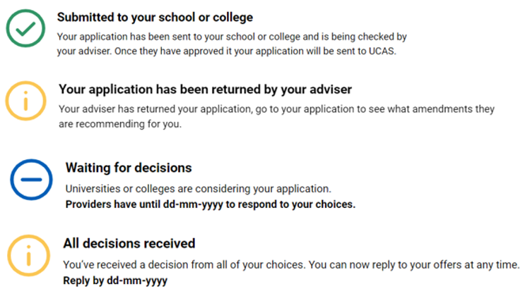
Tracking your application
Follow your application to:
check progress
see your choices
update contact information
view and reply to your offers
One of three decisions:
unconditional offer
conditional offer
unsuccessful
Public
Notes:
Your application will update as the status of your application changes. Click on it to go to your application and see more details. It’s essential that contact information, particularly your email is kept up to date. This can be changed at anytime in the application. We always advise students use a personal email address for their UCAS application so they can have access to this at all times.
You will hear about each of their choices at different times – sometimes you might be contacted very quickly, or it may be several months before you hear anything. To see all the deadlines that universities and colleges must adhere by visit www.ucas.com/key-dates.
An offer will be either conditional or unconditional.
Conditional offer – the offer has conditions. For example, certain qualification results have to be achieved. Unless a different date is specified, the conditions must be met by 3 September (even if entry is deferred to the following year). The conditions may include achievement of specific grades, possibly in named subjects, or a certain number of UCAS Tariff points.
Unconditional offer – this usually the university or college’s entry requirements have already been met for the course. They might still have to meet other requirements, such as financial or medical conditions.
They may also receive:
Unsuccessful – the university or college has not offered a place on the course.

Slide 18
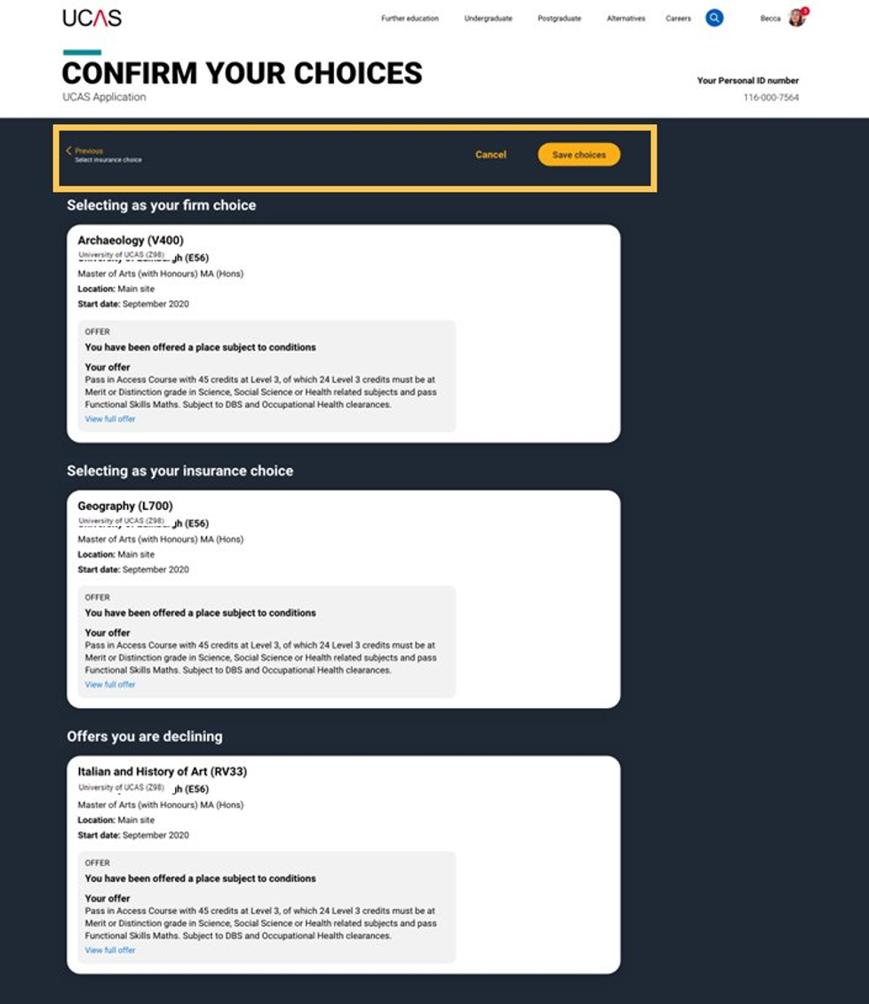
Replies to offers
Once you've made your decisions, choose a 'firm' and 'insurance' choice.
Decline any remaining offers.
If you're not holding an offer, use Extra or Clearing to find available places.
Public
Notes:
When you’ve had all decisions from your choices, you need to decide which one(s) you want to accept. The date you must reply to your offers is shown in your application.
You can accept one offer as your firm choice.
If that’s a conditional offer, you can accept a second offer as an insurance choice, if you want to, in case you don’t meet the conditions of your firm choice.
You don’t have to have an insurance choice. If you aren’t sure any of your other offers are right for you, it might be better to wait and see what’s available in Clearing once you have your results.
Remaining offers are automatically declined when the 'Firm' and 'Insurance' are selected.
If you firmly accept an unconditional offer, you cannot hold an insurance choice.
Choosing the right course and university or college is a very important decision, and it can be difficult to change later in the admissions process. To help you make an informed decision about where to apply, what to study, and whether to accept an offer, the university or college you should read all the information the university or college has shared with you; before making a decision. You need to think very carefully, and make sure you do not accept an offer from any university or college if they you’re not prepared to study there.
AN IMPORTANT MESSAGE FOR YOUR STUDENTS
If you don’t reply to your offers on or before the reply date shown in your application UCAS will decline them on your behalf (often referred to as declined by default [DBD]). This means you will lose all your offers.
TOP TIP
Before making any decisions, encourage your students to take a look at our advice on making informed choices – www.ucas.com/undergraduate/after-you-apply/making-right-decision

